Slide 1
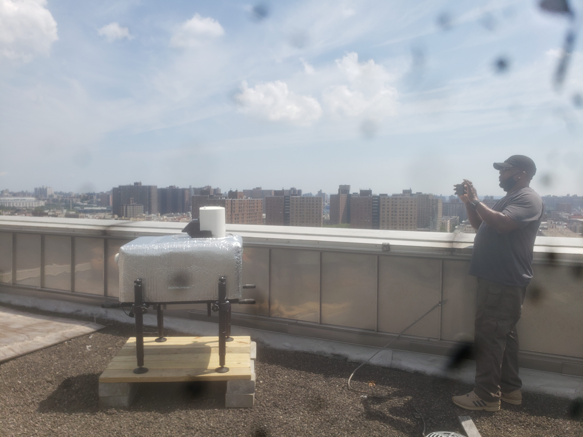
Deployment of DOD Doppler Lidar
On Top of City College Building in NYC
(Used for BOTH Wind Observations and Terrain Mapping)

Slide 2
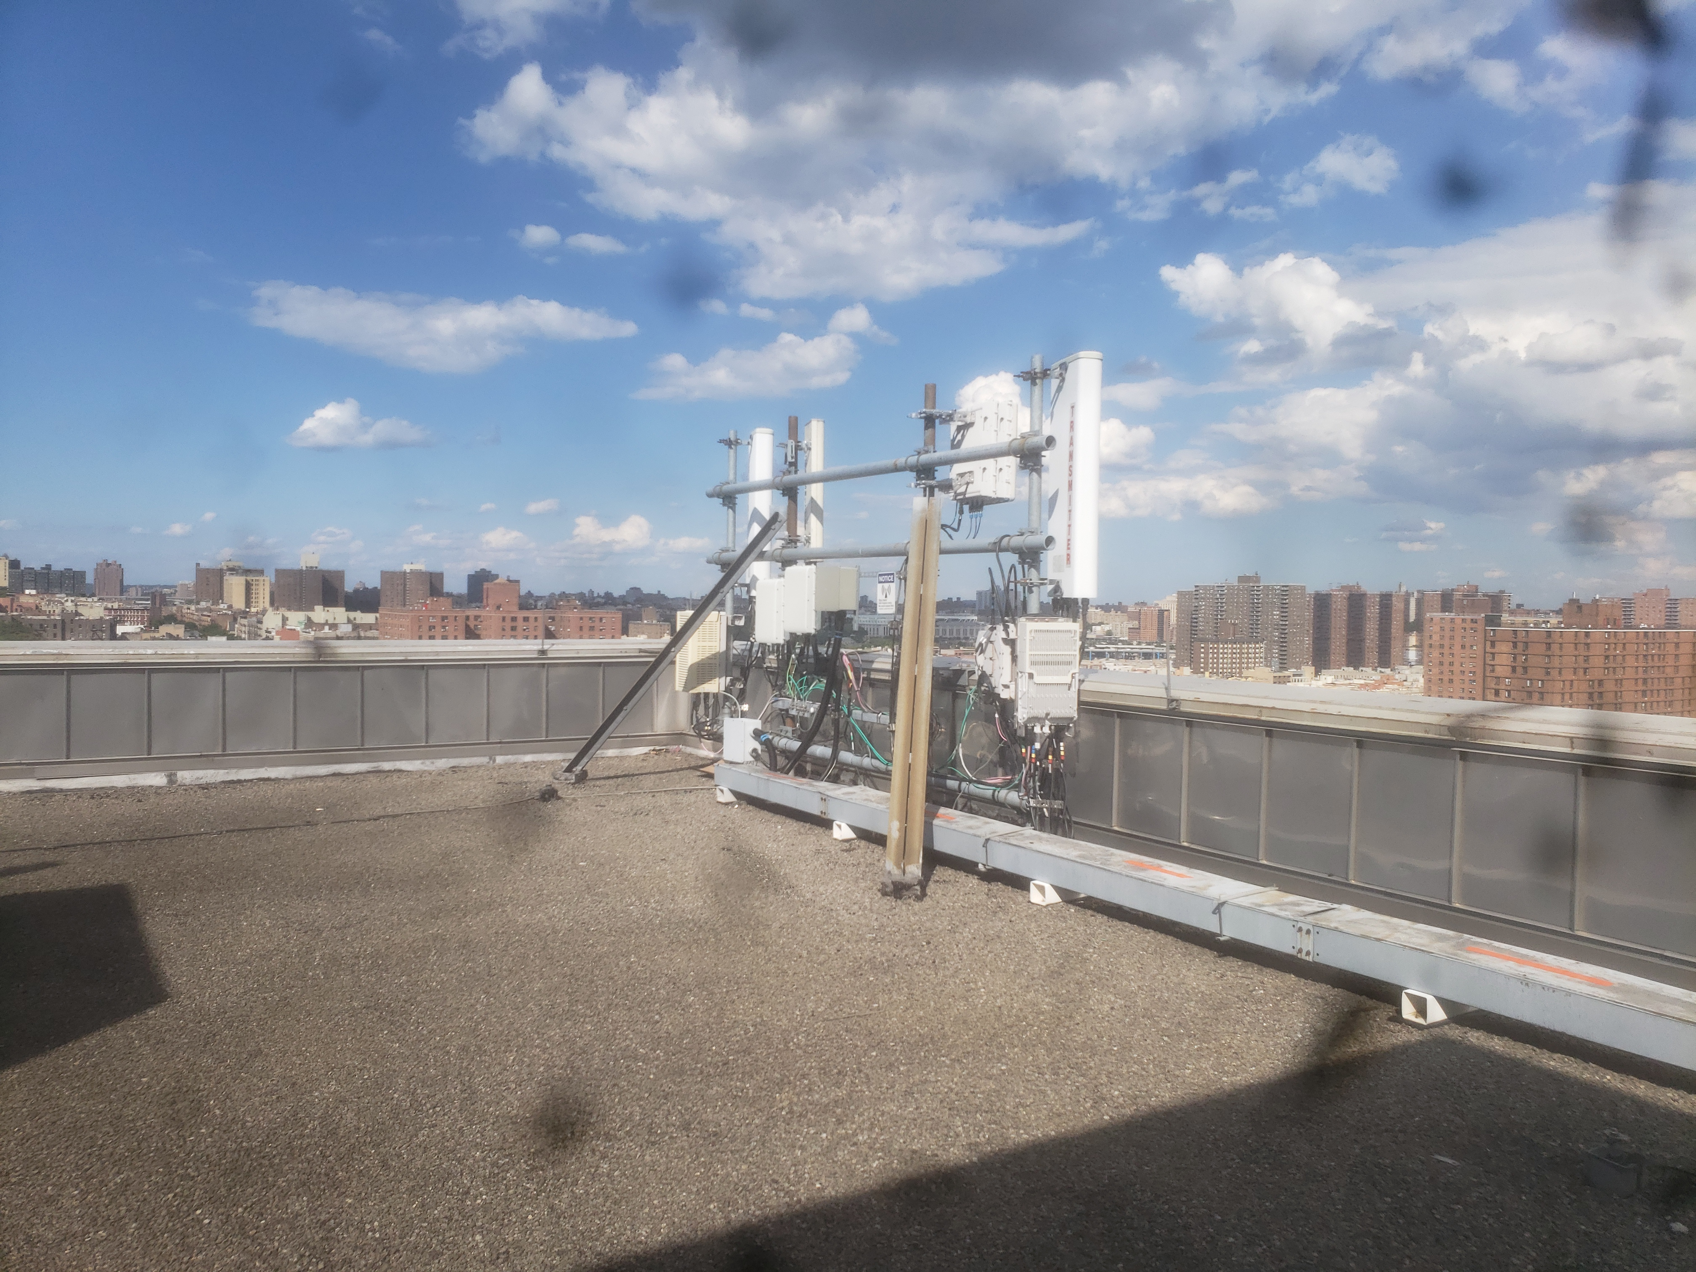
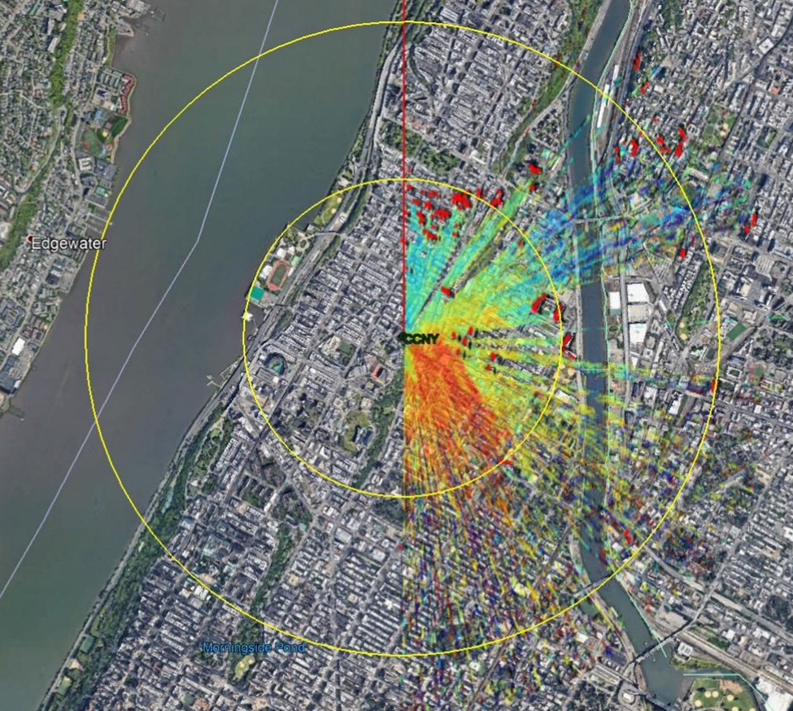
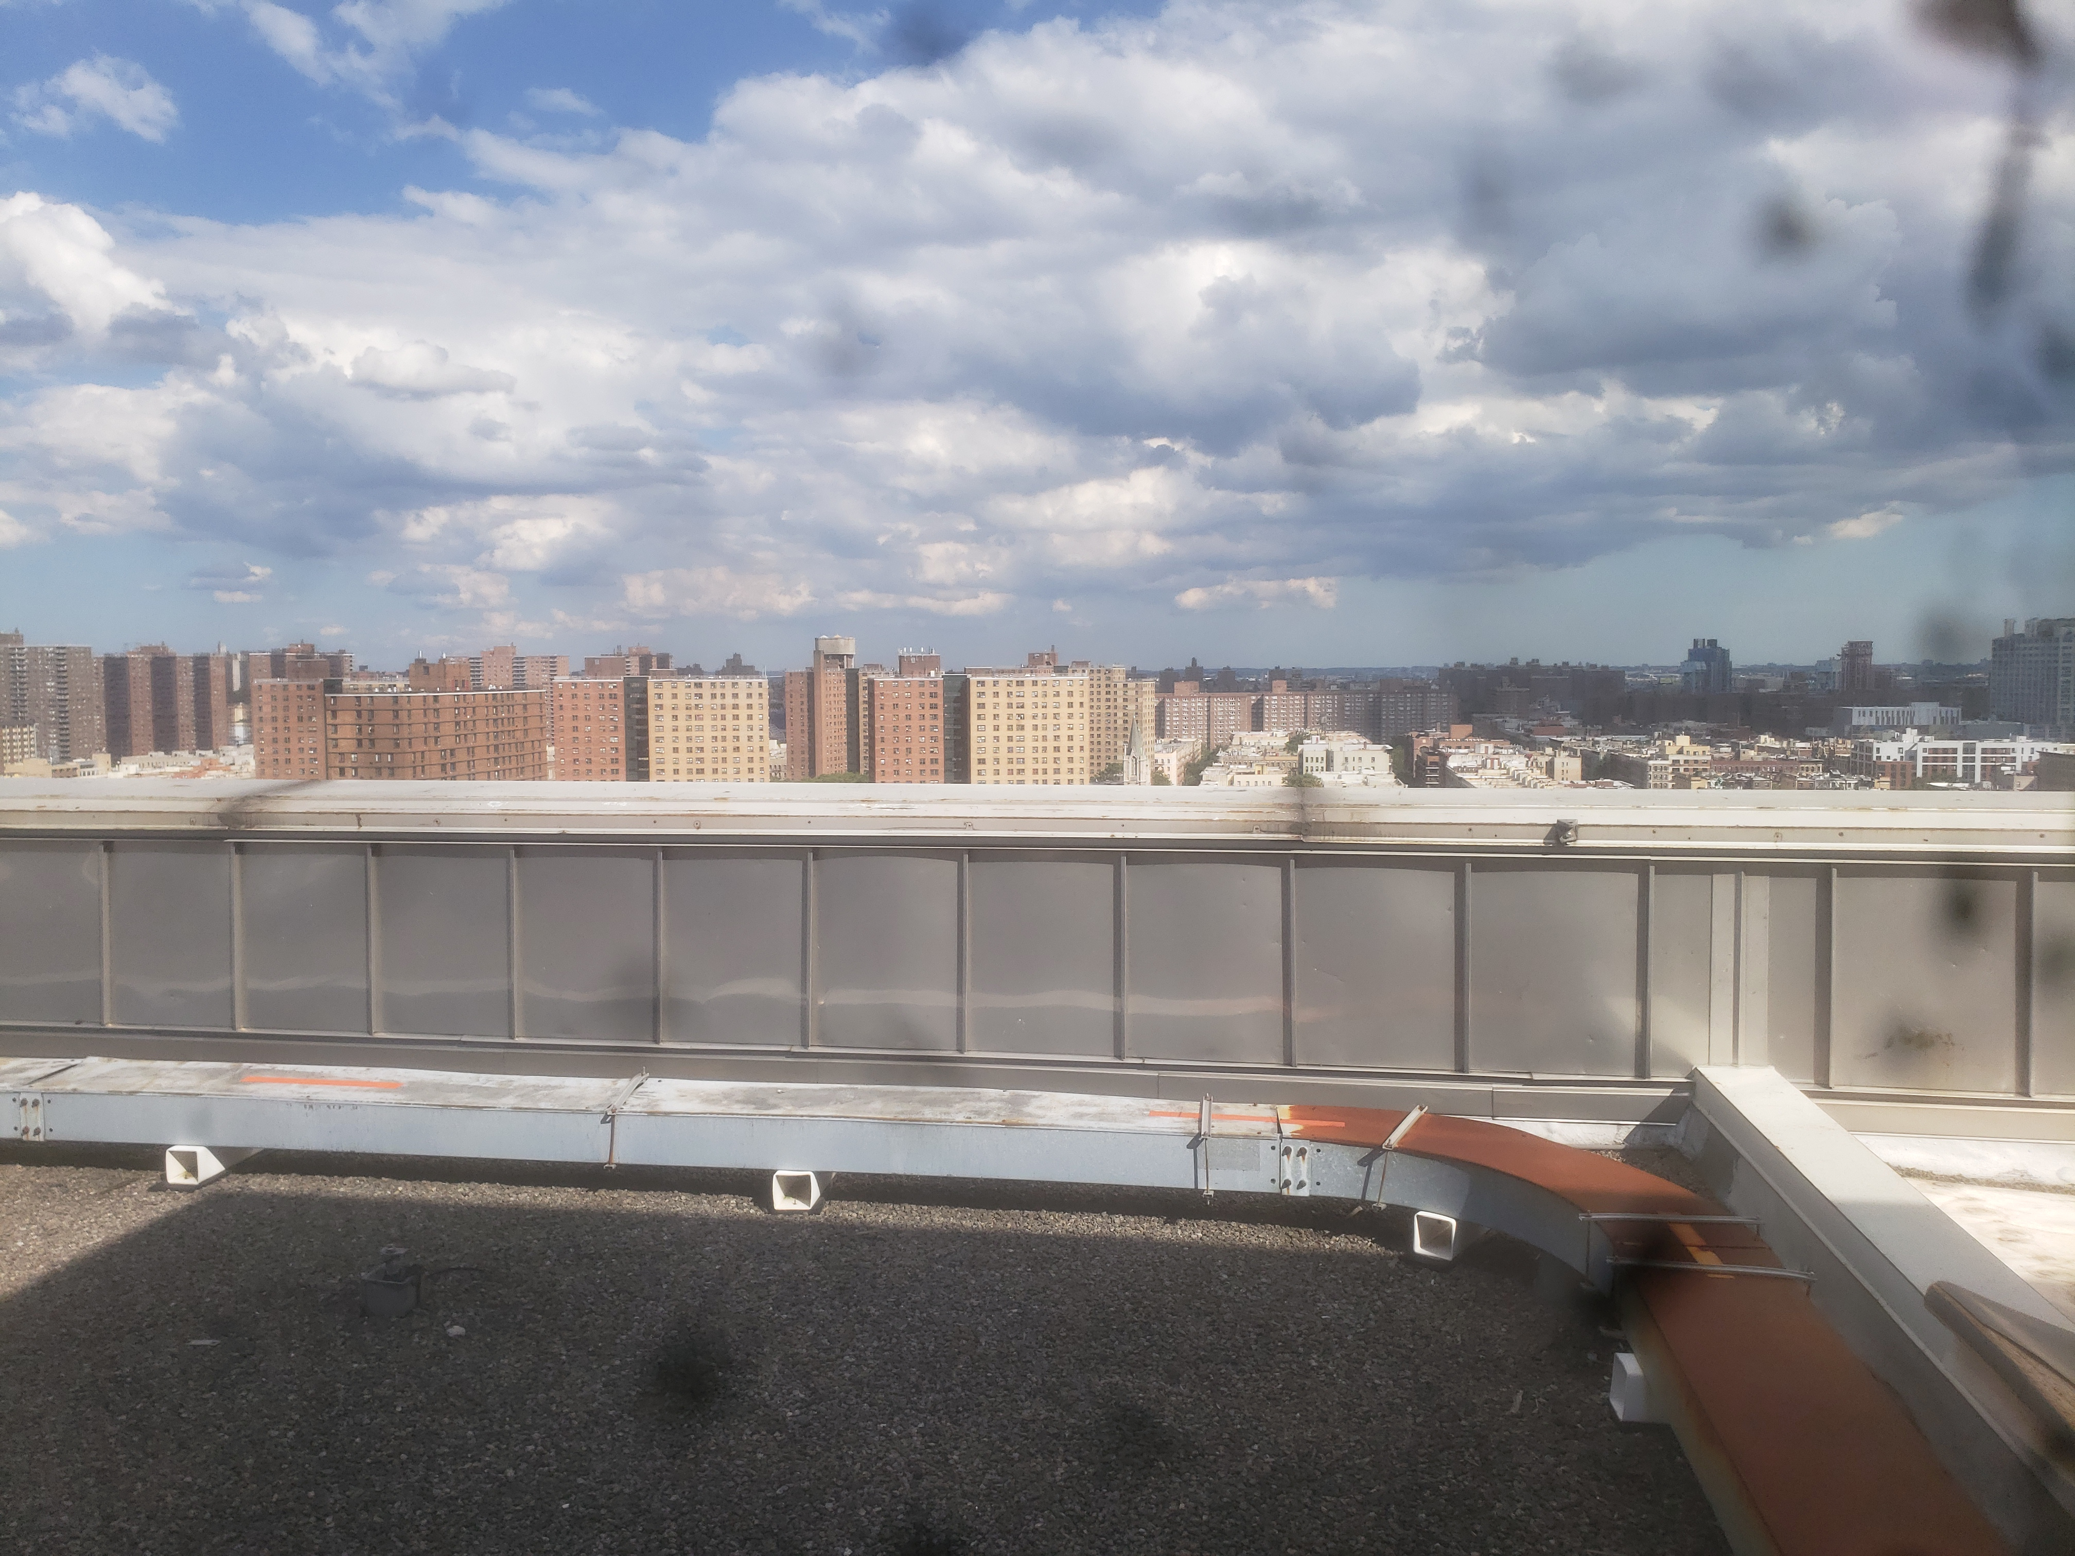
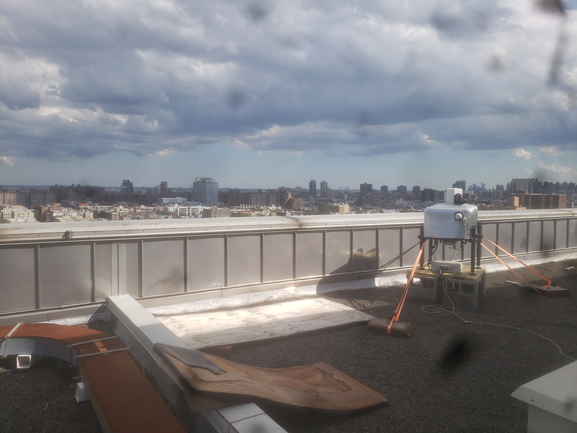
Hard Target Lidar Terrain Mapping
Along Side Pictures Taken at LIDAR location
(Tall Buildings Highlighted Red)
1
1
2
2
3
3

