Slide 1



Doppler Wind Lidar Observations Combined with High Resolution Urban Terrain Mapping
Mark Arend^{1,2*}, David A Ligon³ , Deryck James³ George Elkik¹
Prathap Ramamurthy^{2,4}, Fred Moshary^{1,2}
¹Electrical Engineering Department, CUNY City College of New York
²NOAA-Center for Earth System Science and Remote Sensing Technologies, CUNY City College of New York
³US Army Research Lab, Department of Defense
⁴Mechanical Engineering Department, CUNY City College of New York
*marend@ccny.cuny.edu

Slide 2
Overview
Introduction and Motivation/Challenges
Instruments Deployed in NY Metro Region
Brief Description of Urban Terrain Mapping
Doppler Lidar Scanning Strategies
Observations and Results
Conclusions and Future Study

Slide 3
Introduction and Motivation/Challenges
Densely populated urban regions with gridded structures and urban canyons have a major impact on the evolution of the Planetary Boundary Layer (PBL) Dynamics
PBL Dynamics impacts the transport of pollutants in Urban Regions
Aerosol Transport in Urban Regions has become a major issue in recent times (especially due to COVID-19)
Observing Turbulence in Densely Populated Urban Regions involves the deployment of various instruments to remotely monitor the Urban Atmosphere

Slide 4
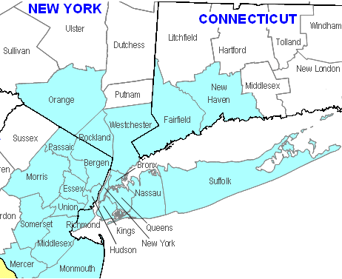
Challenges
LONG ISLAND SOUND
ATLANTIC OCEAN
NEW JERSEY
NY/NJ/CT Airshed crosses multiple state, municipal, and marine boundaries. Urban-costal interactions, Urban/Rural Landcover Gradients and Population Gradients complicates the PBL Dynamics and Pollution Transport Regulation across Boundaries

Slide 5
Objectives
Assess atmospheric conditions using Doppler LIDAR supplemented with other ground based remote sensing and in-situ instruments.
Deploy various instruments to remotely monitor the Urban Atmosphere
Characterize the Urban Terrain at high resolution
Observe the vertical and horizontal advection in densely populated urban areas.
Measure and contrast the daytime Mixing Layer Height during select events.

Slide 6
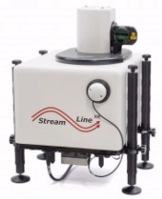
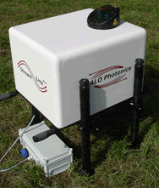
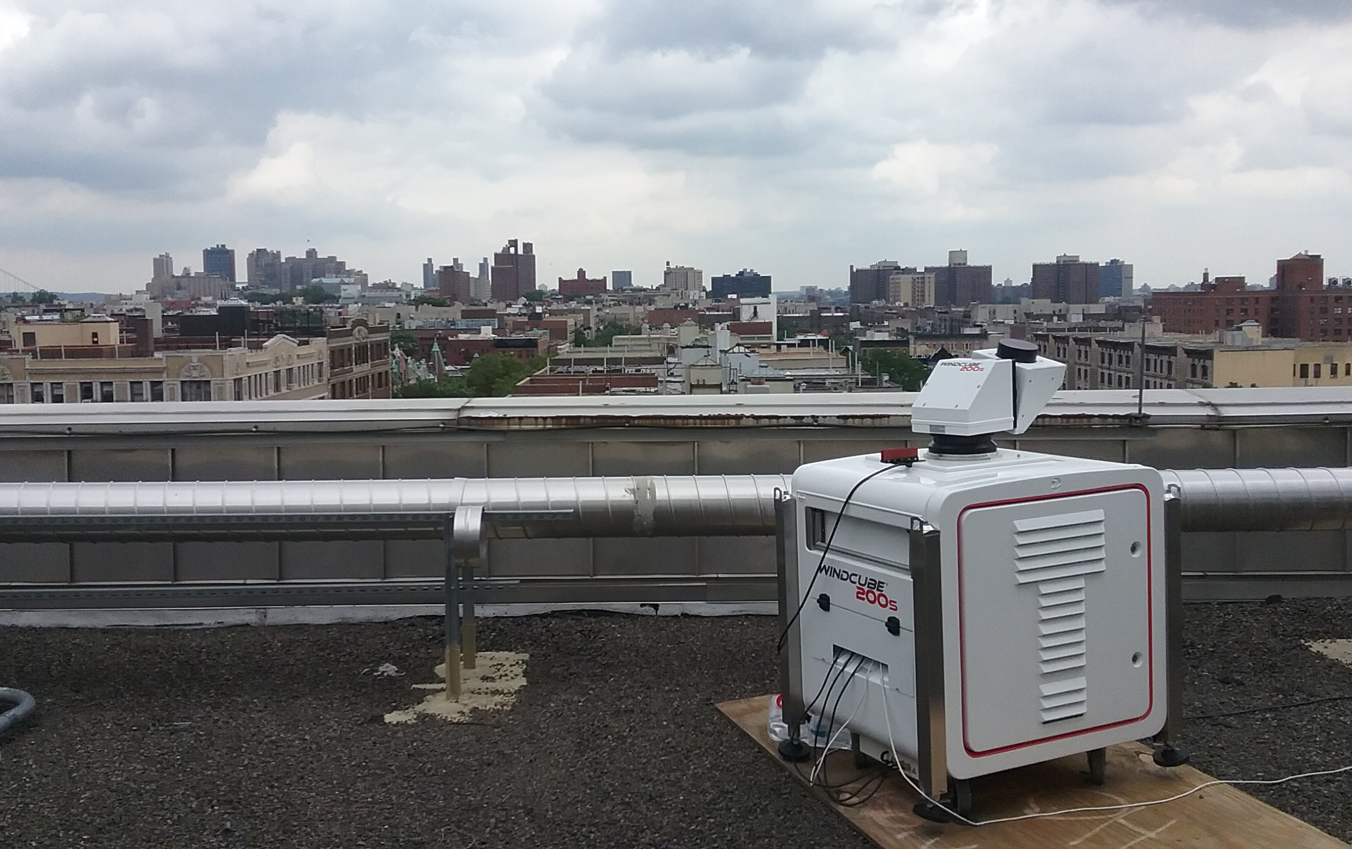
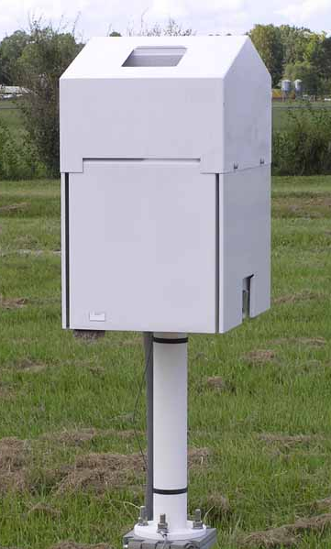
Instruments Deployed in NY Metro Region
(2019- 2020)
Supporting Lidar Instruments Operated by CCNY and DOD
Halo Streamline
Fixed RHI scans to detect turbulent structures
Vaisala Leosphere 200S
Conical Scans
RHI Scans
Halo Pro
Fixed Conical scans to detect sustained winds
Ceilometer (Viasalia)
Backscatter Gradient MLH Observations

Slide 7
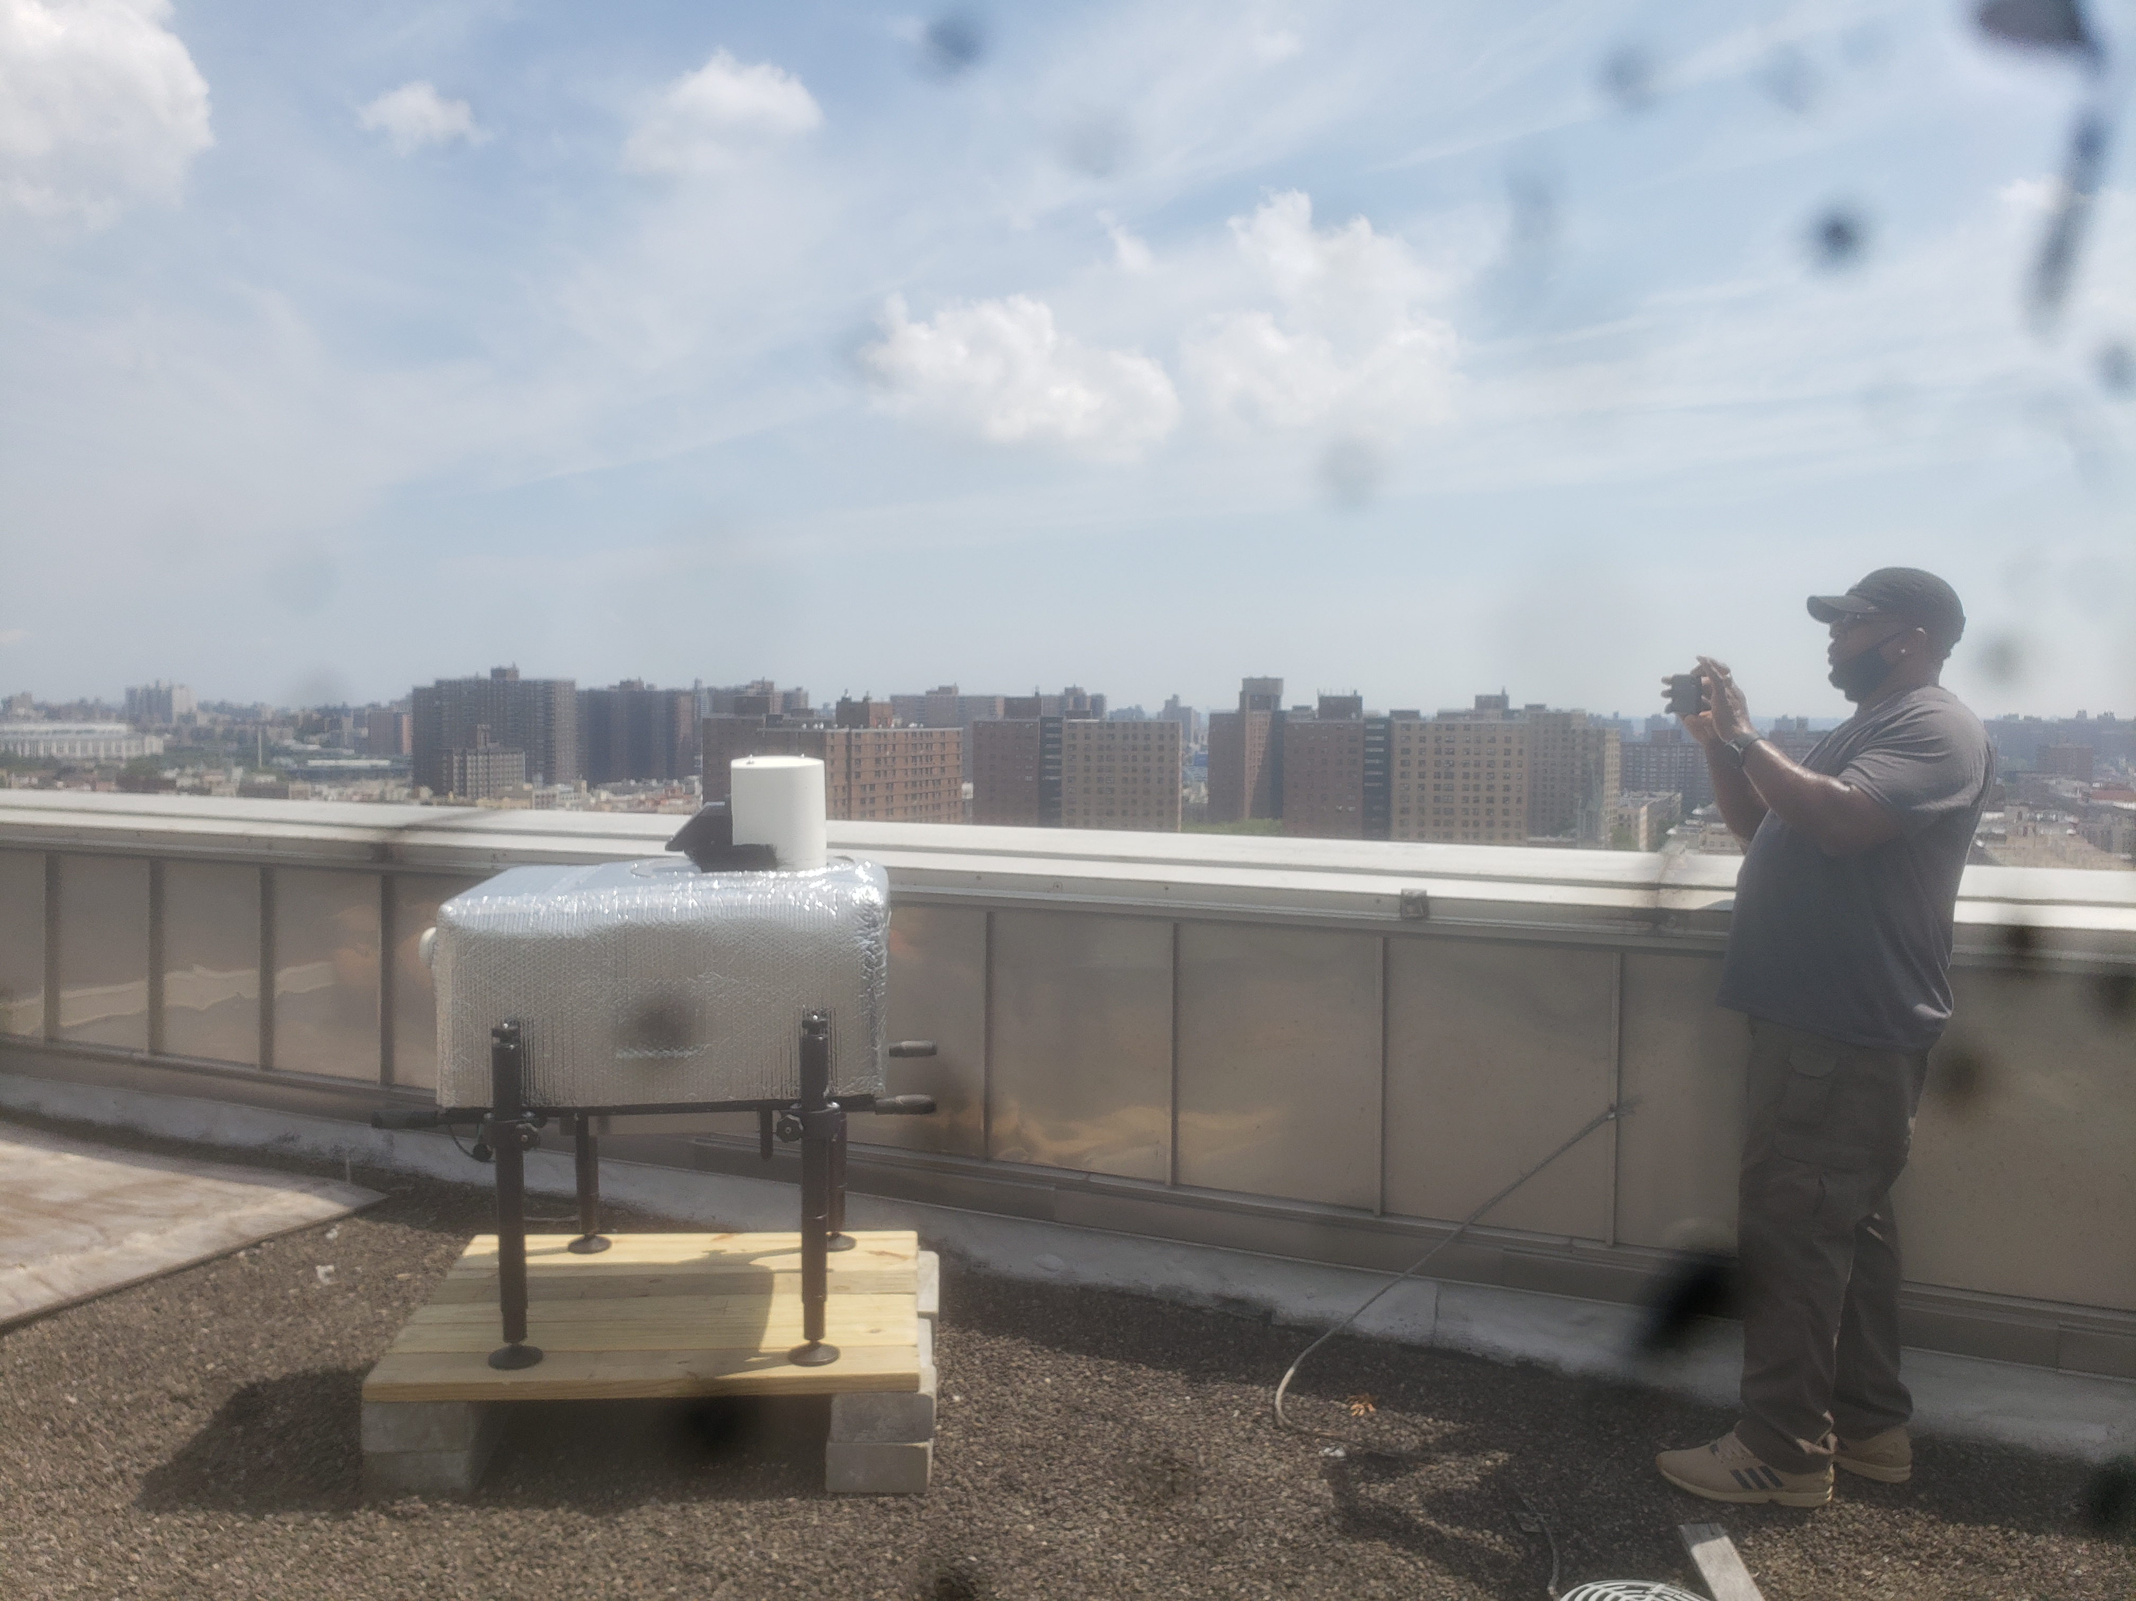
Deployment of DOD Doppler Lidar Summer 2020
On Top of City College Building in NYC
(Used for BOTH Wind Observations and Terrain Mapping)

Slide 8
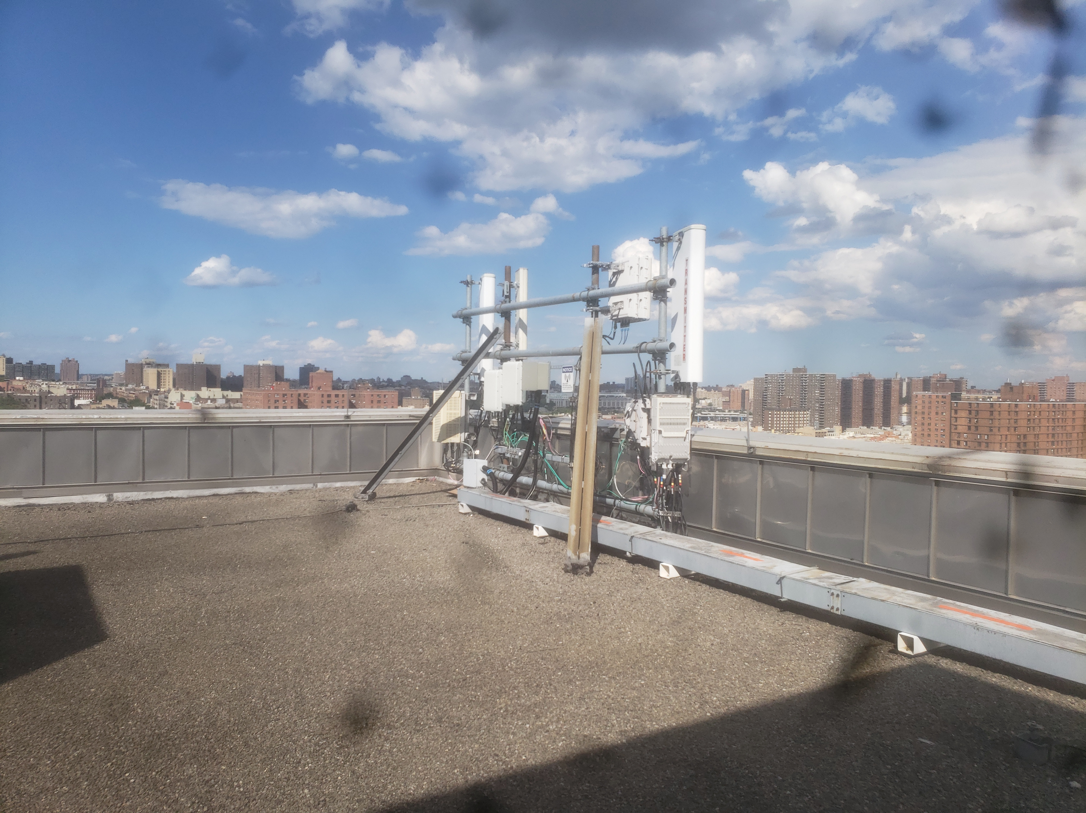
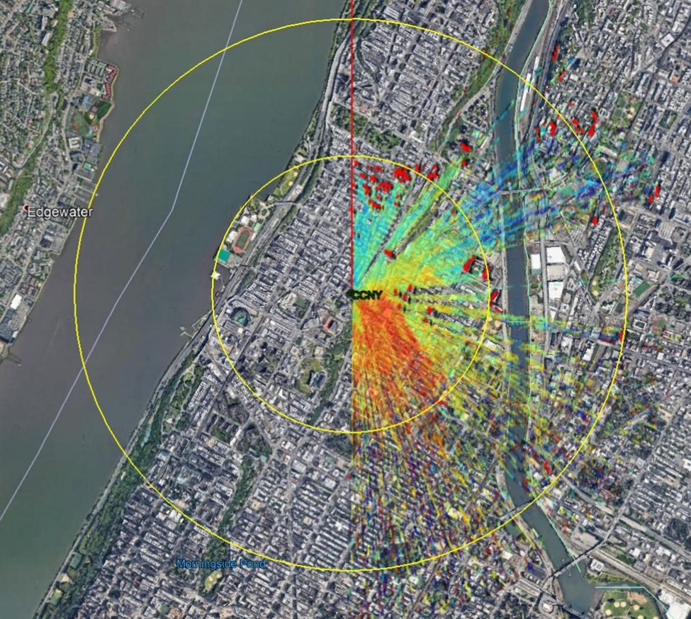
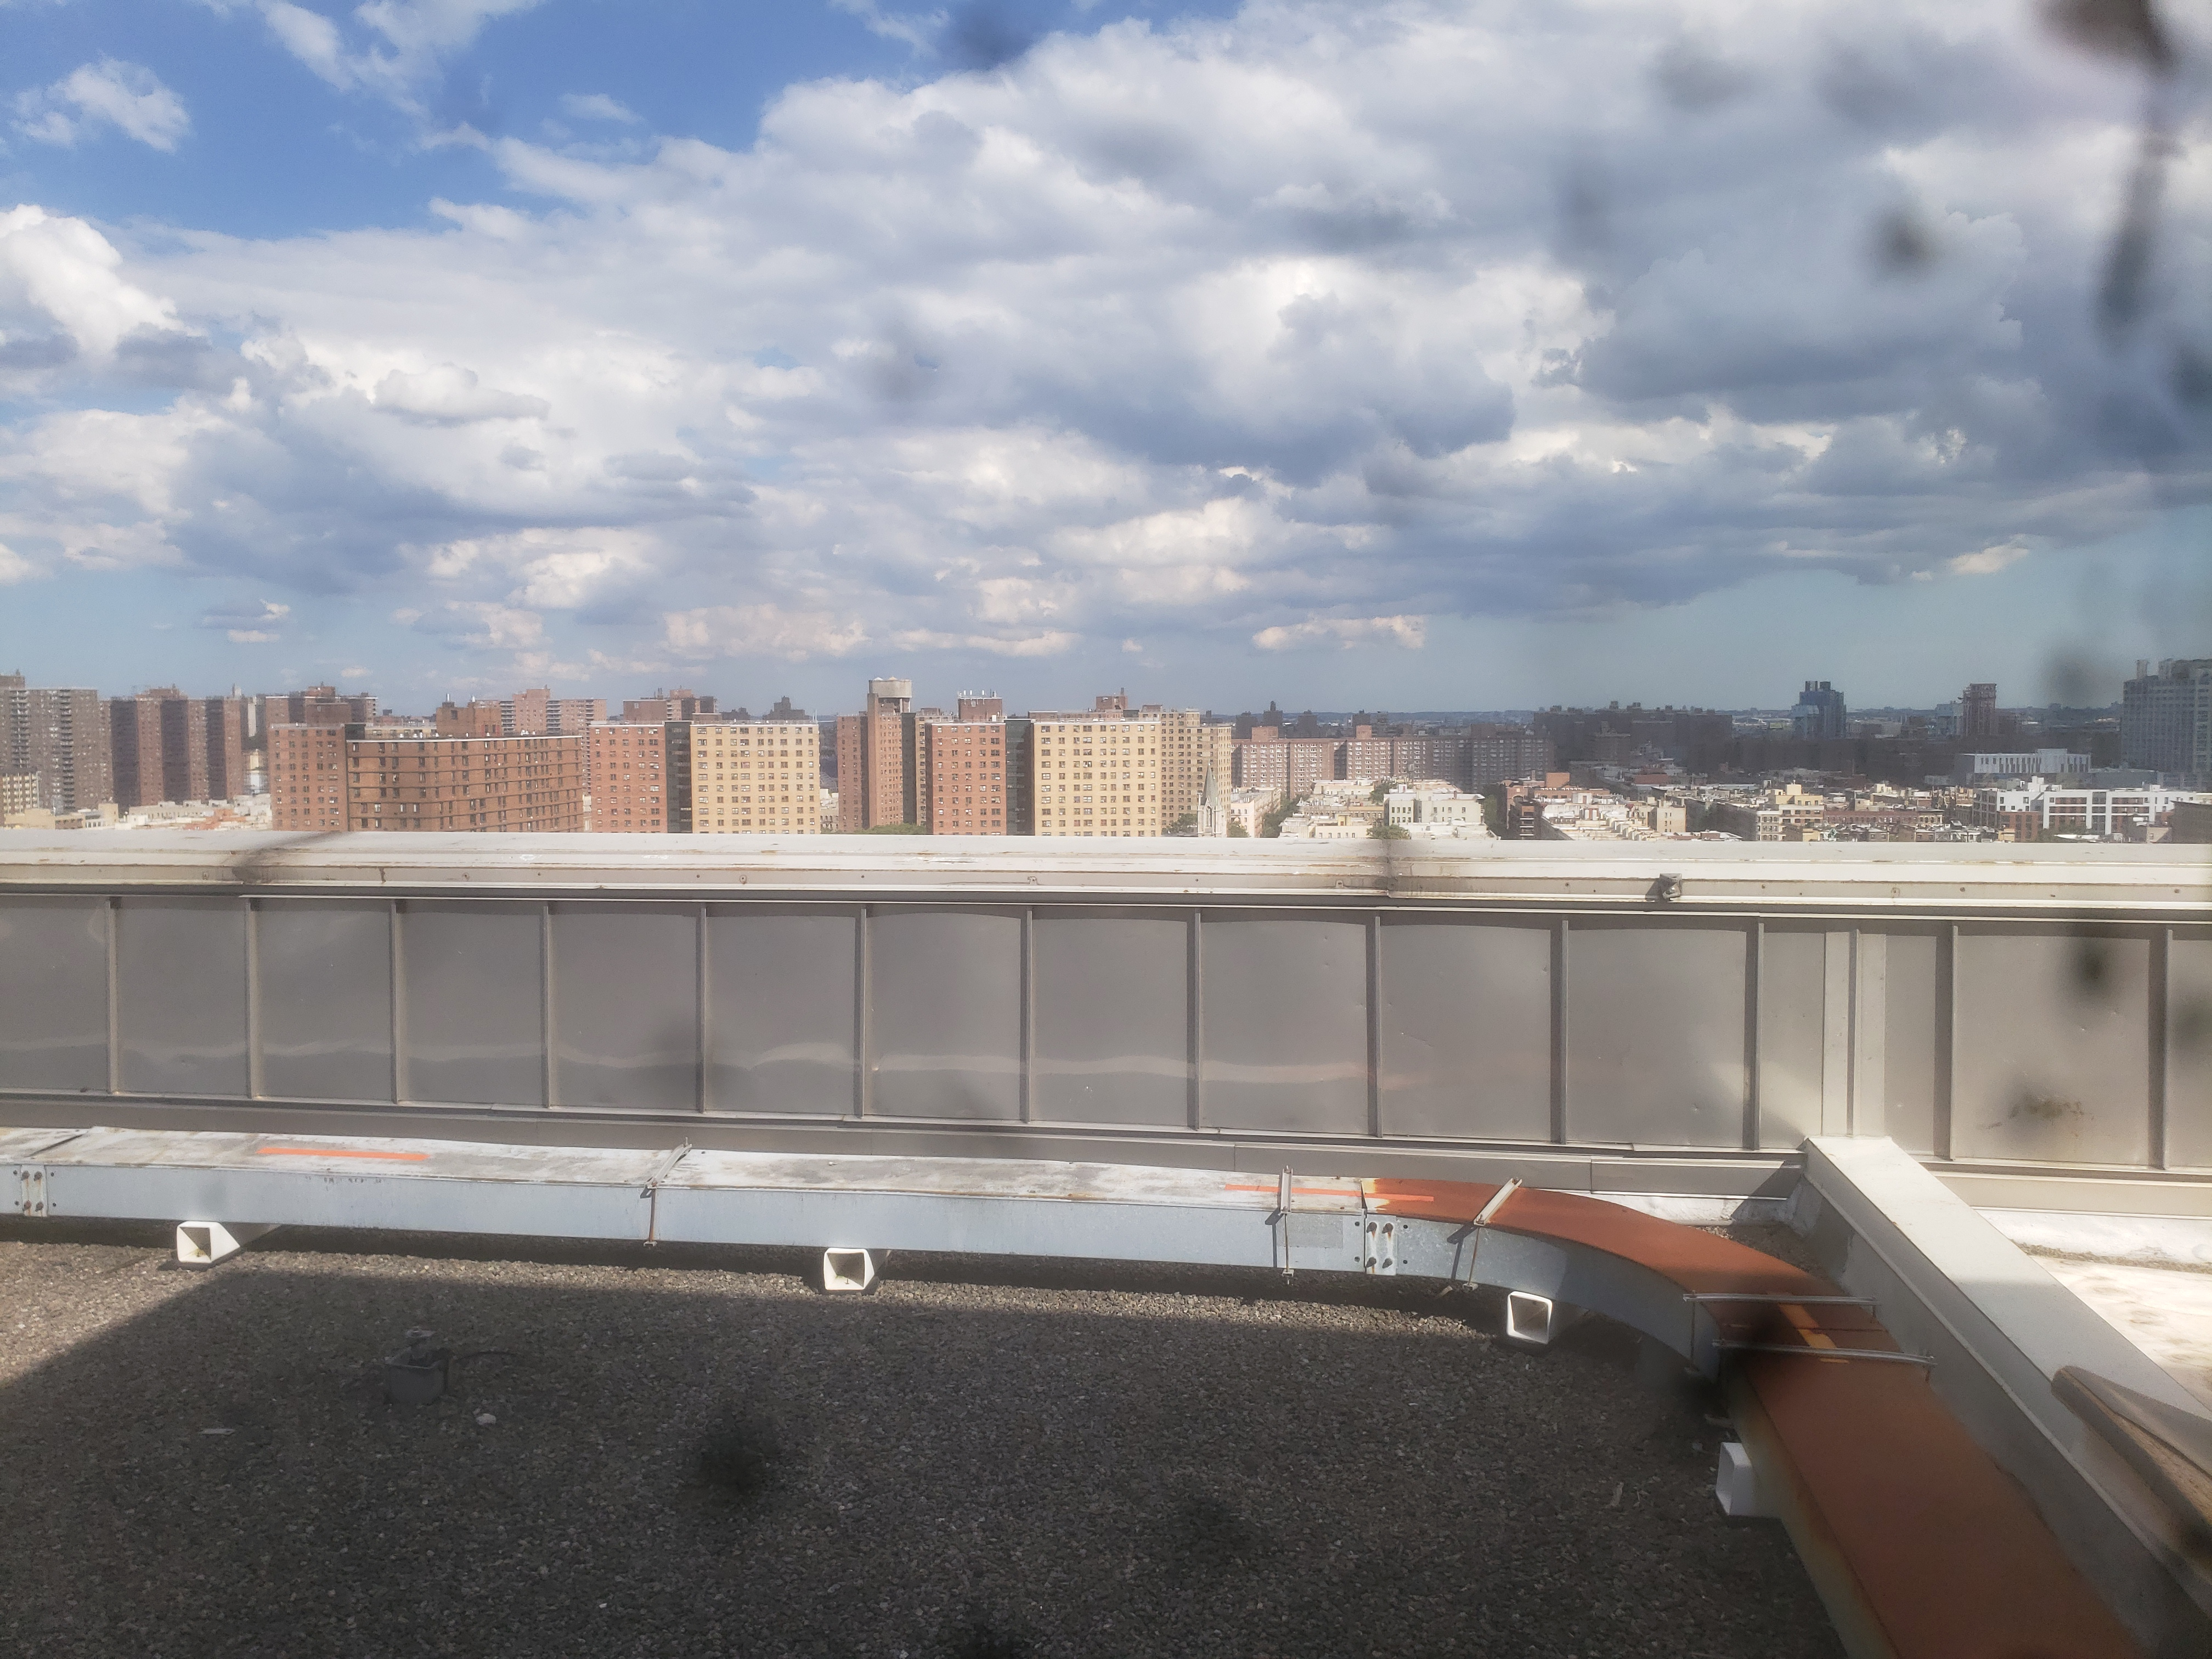
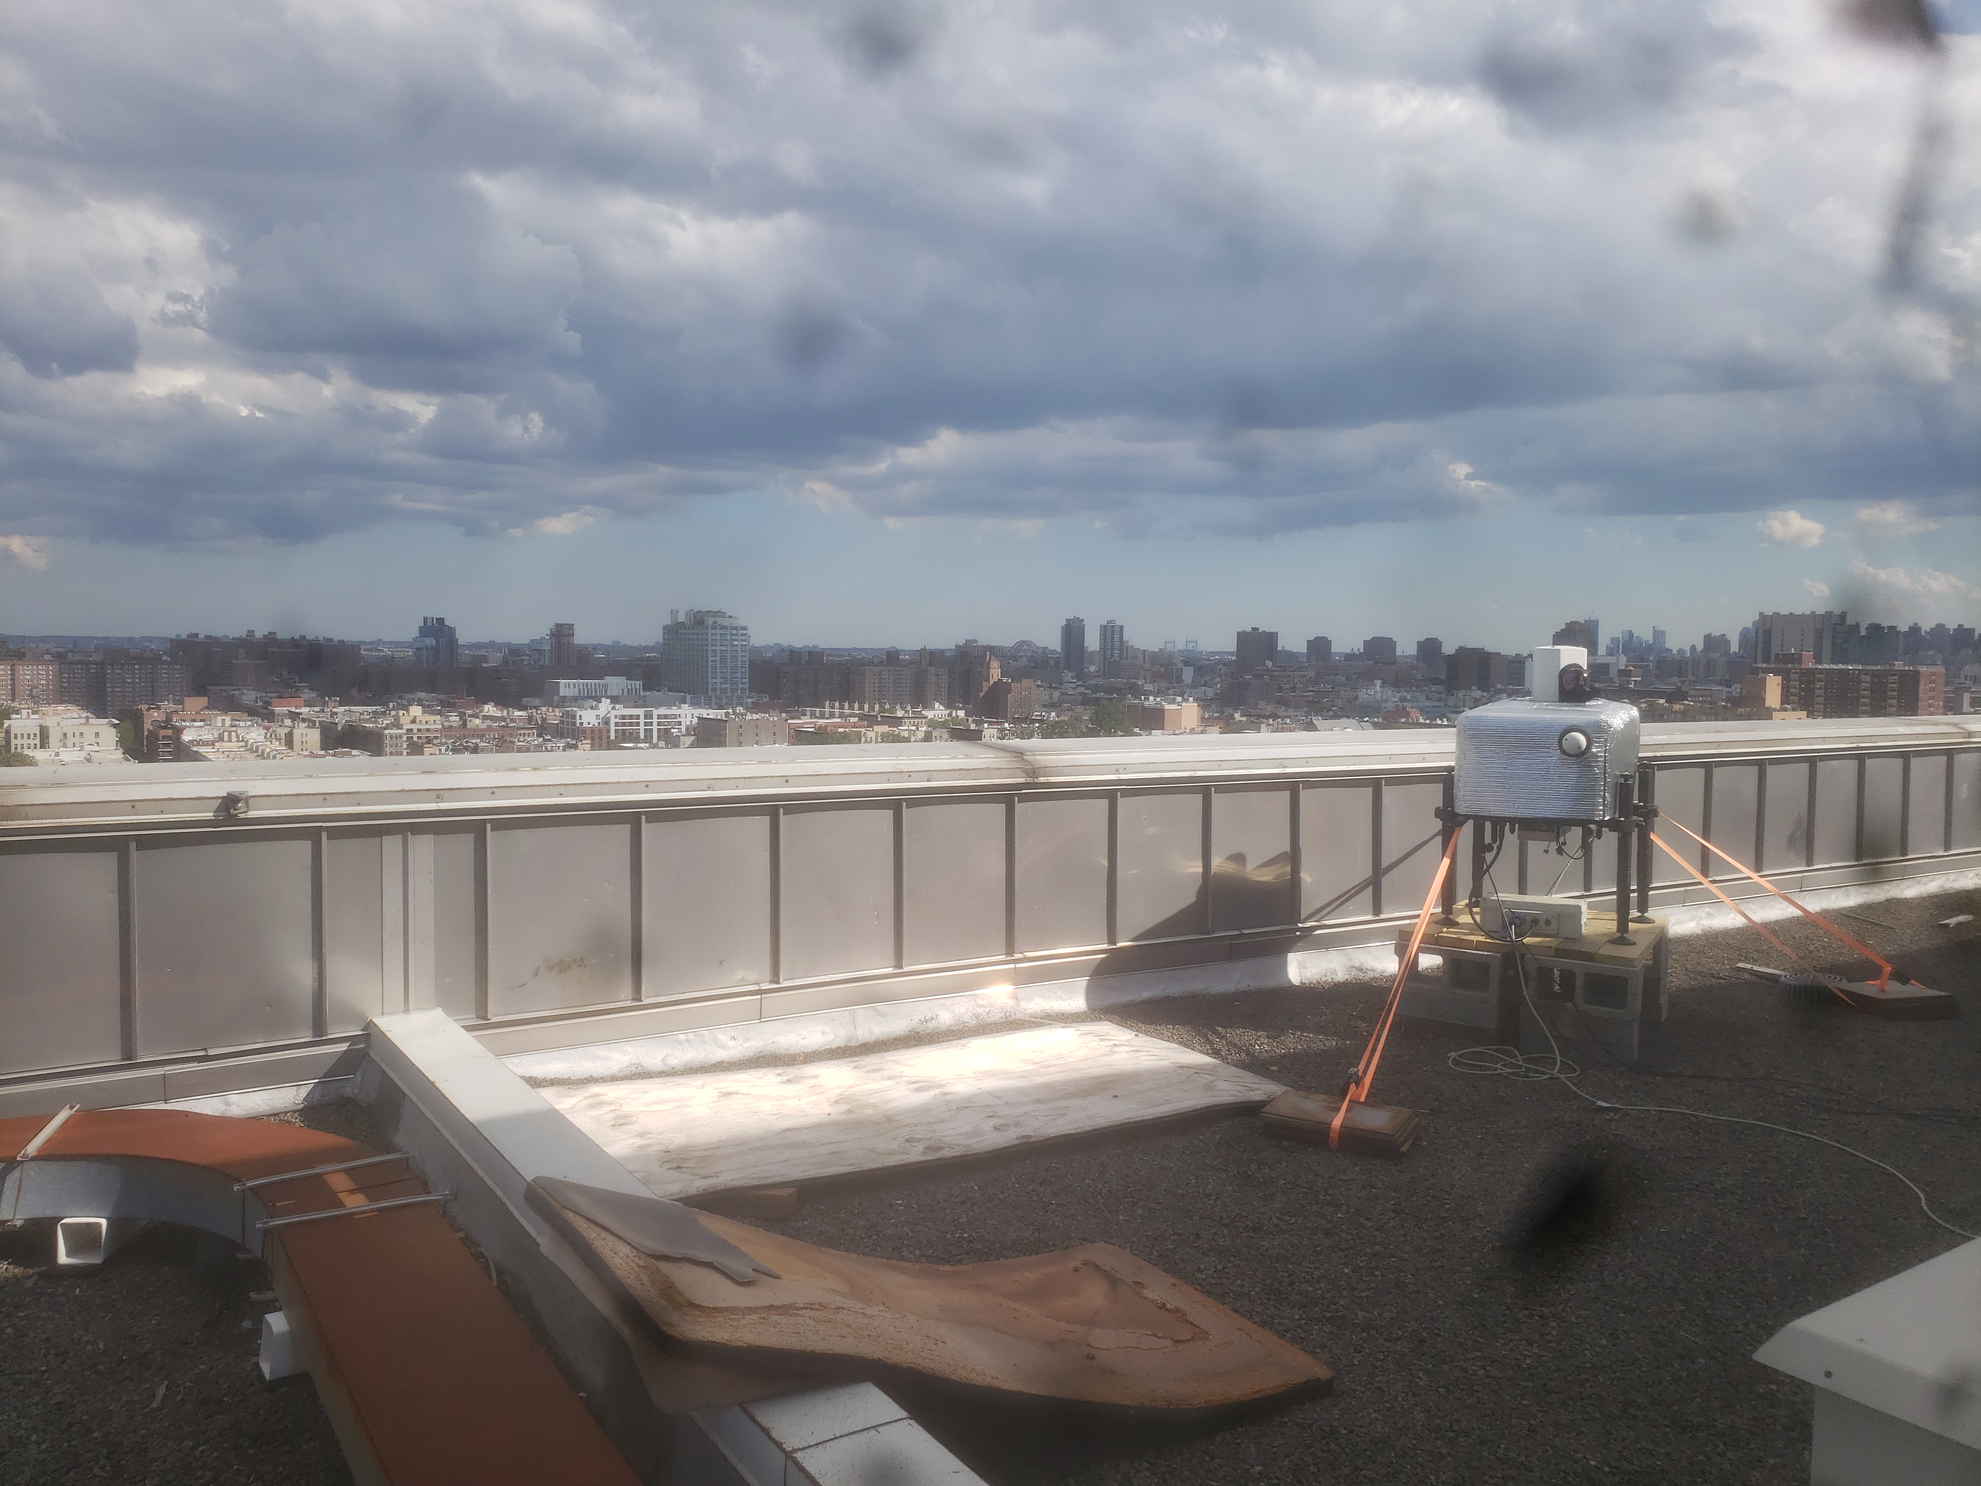
Hard Target Terrain Mapping
Along Side Pictures Taken at LIDAR location
(Tall Buildings Highlighted Red)
1
1
2
2
3
3

Slide 9
Hard Target Terrain Mapping
DAVID WILL PUT IN MORE SLIDES HERE
Highlight the Process
Include some more plots/pictures
(if there are
Khglgf

Slide 10
Observations and Results
2019 instrument deployment involved transportation of instruments to various locations in the NY Metro area
2020 deployment was restricted because of COVID-19 but DOD was allowed “special access” to City College Campus (but access is NOW more restrictive)

Slide 11
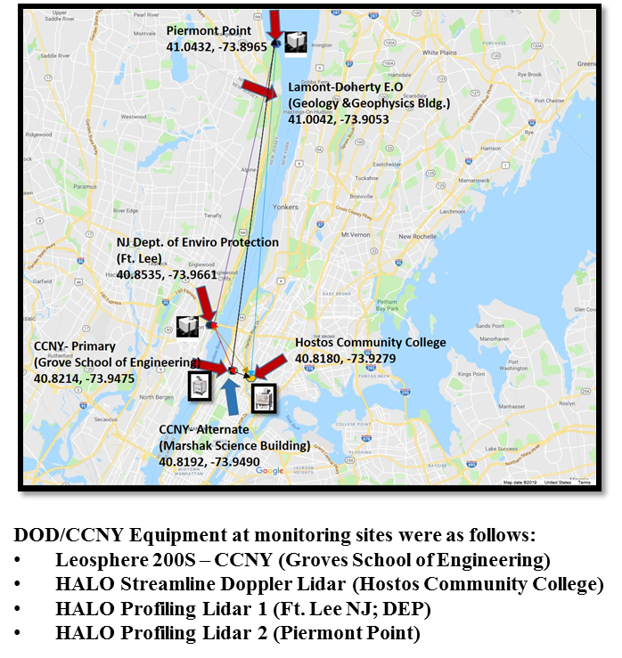
DOD/CCNY Deployment Efforts Observations and Results 2019 (Select Event Aug. 27 2019)

Slide 12
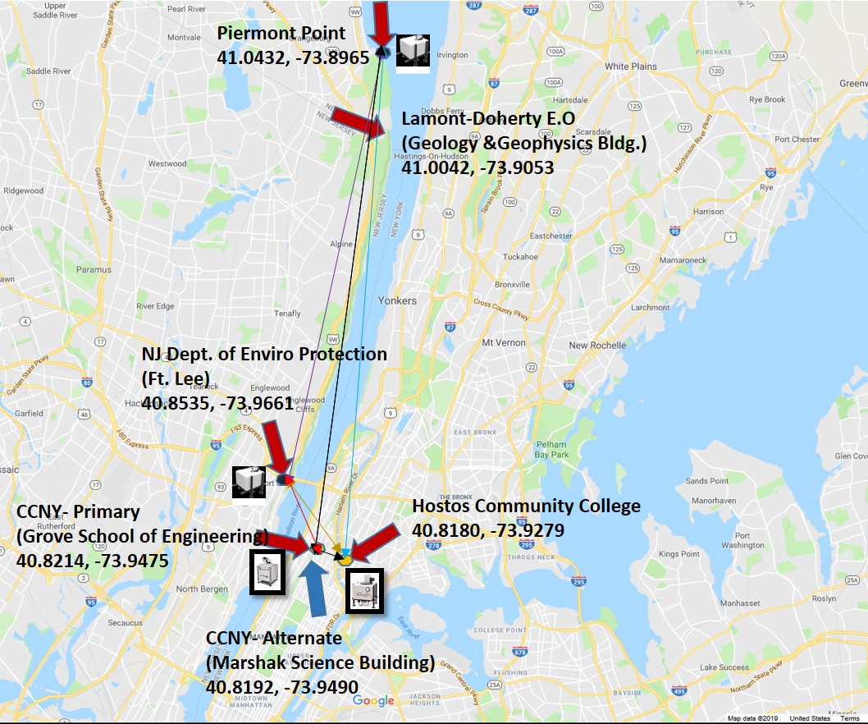
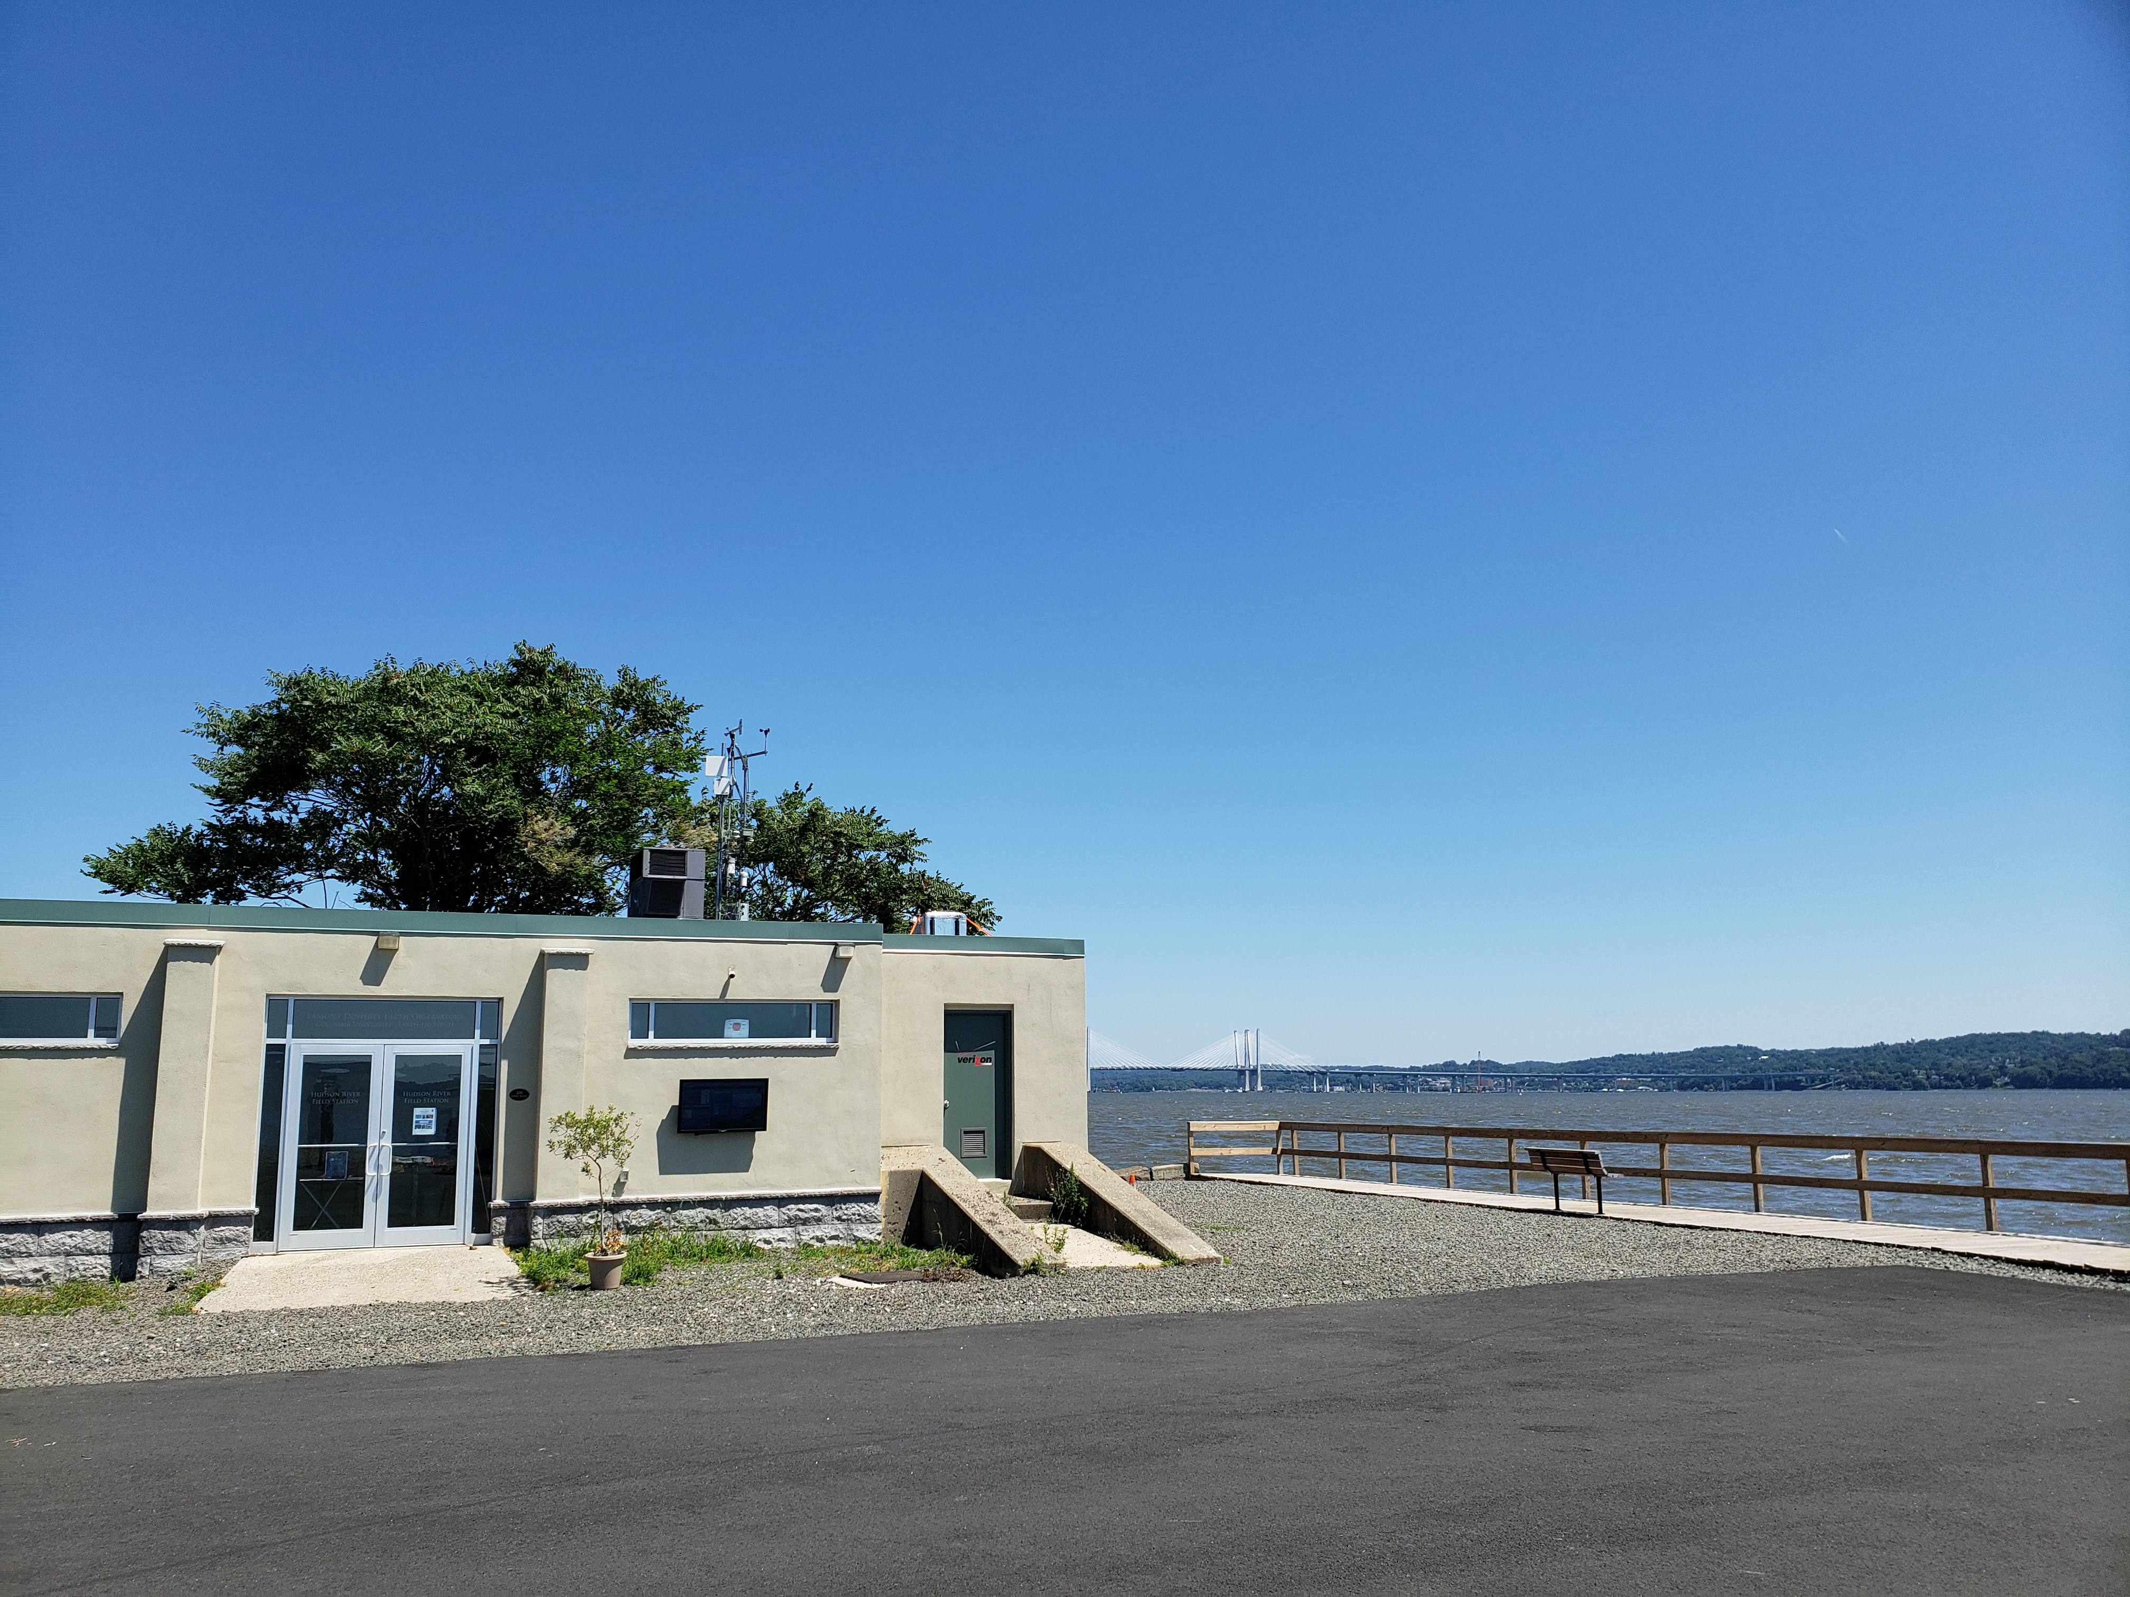
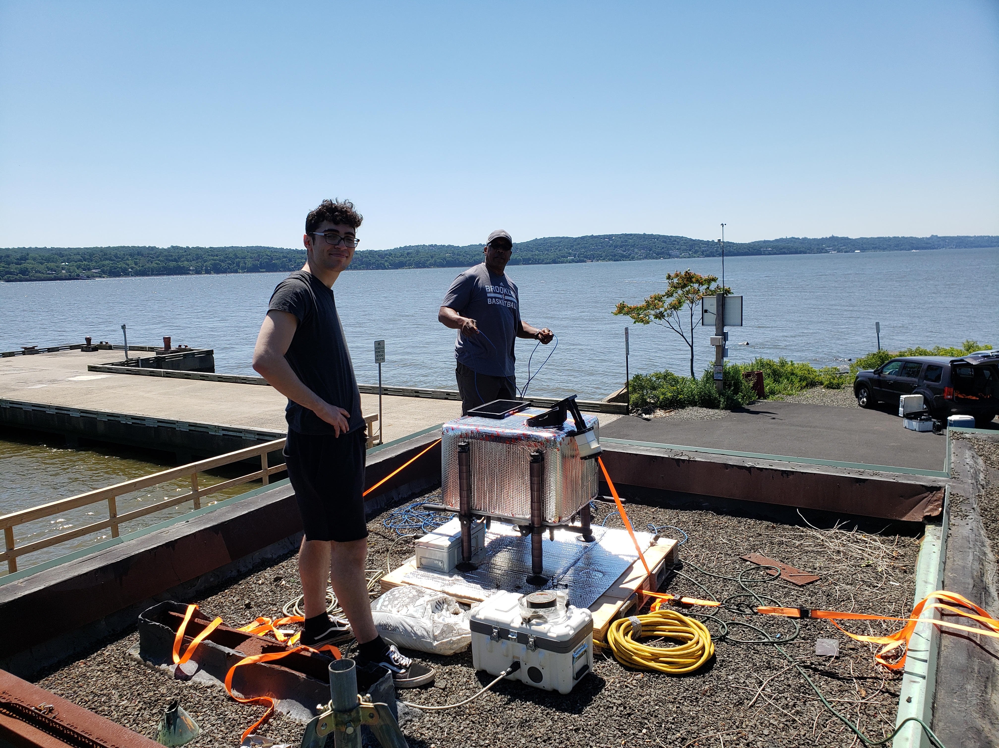
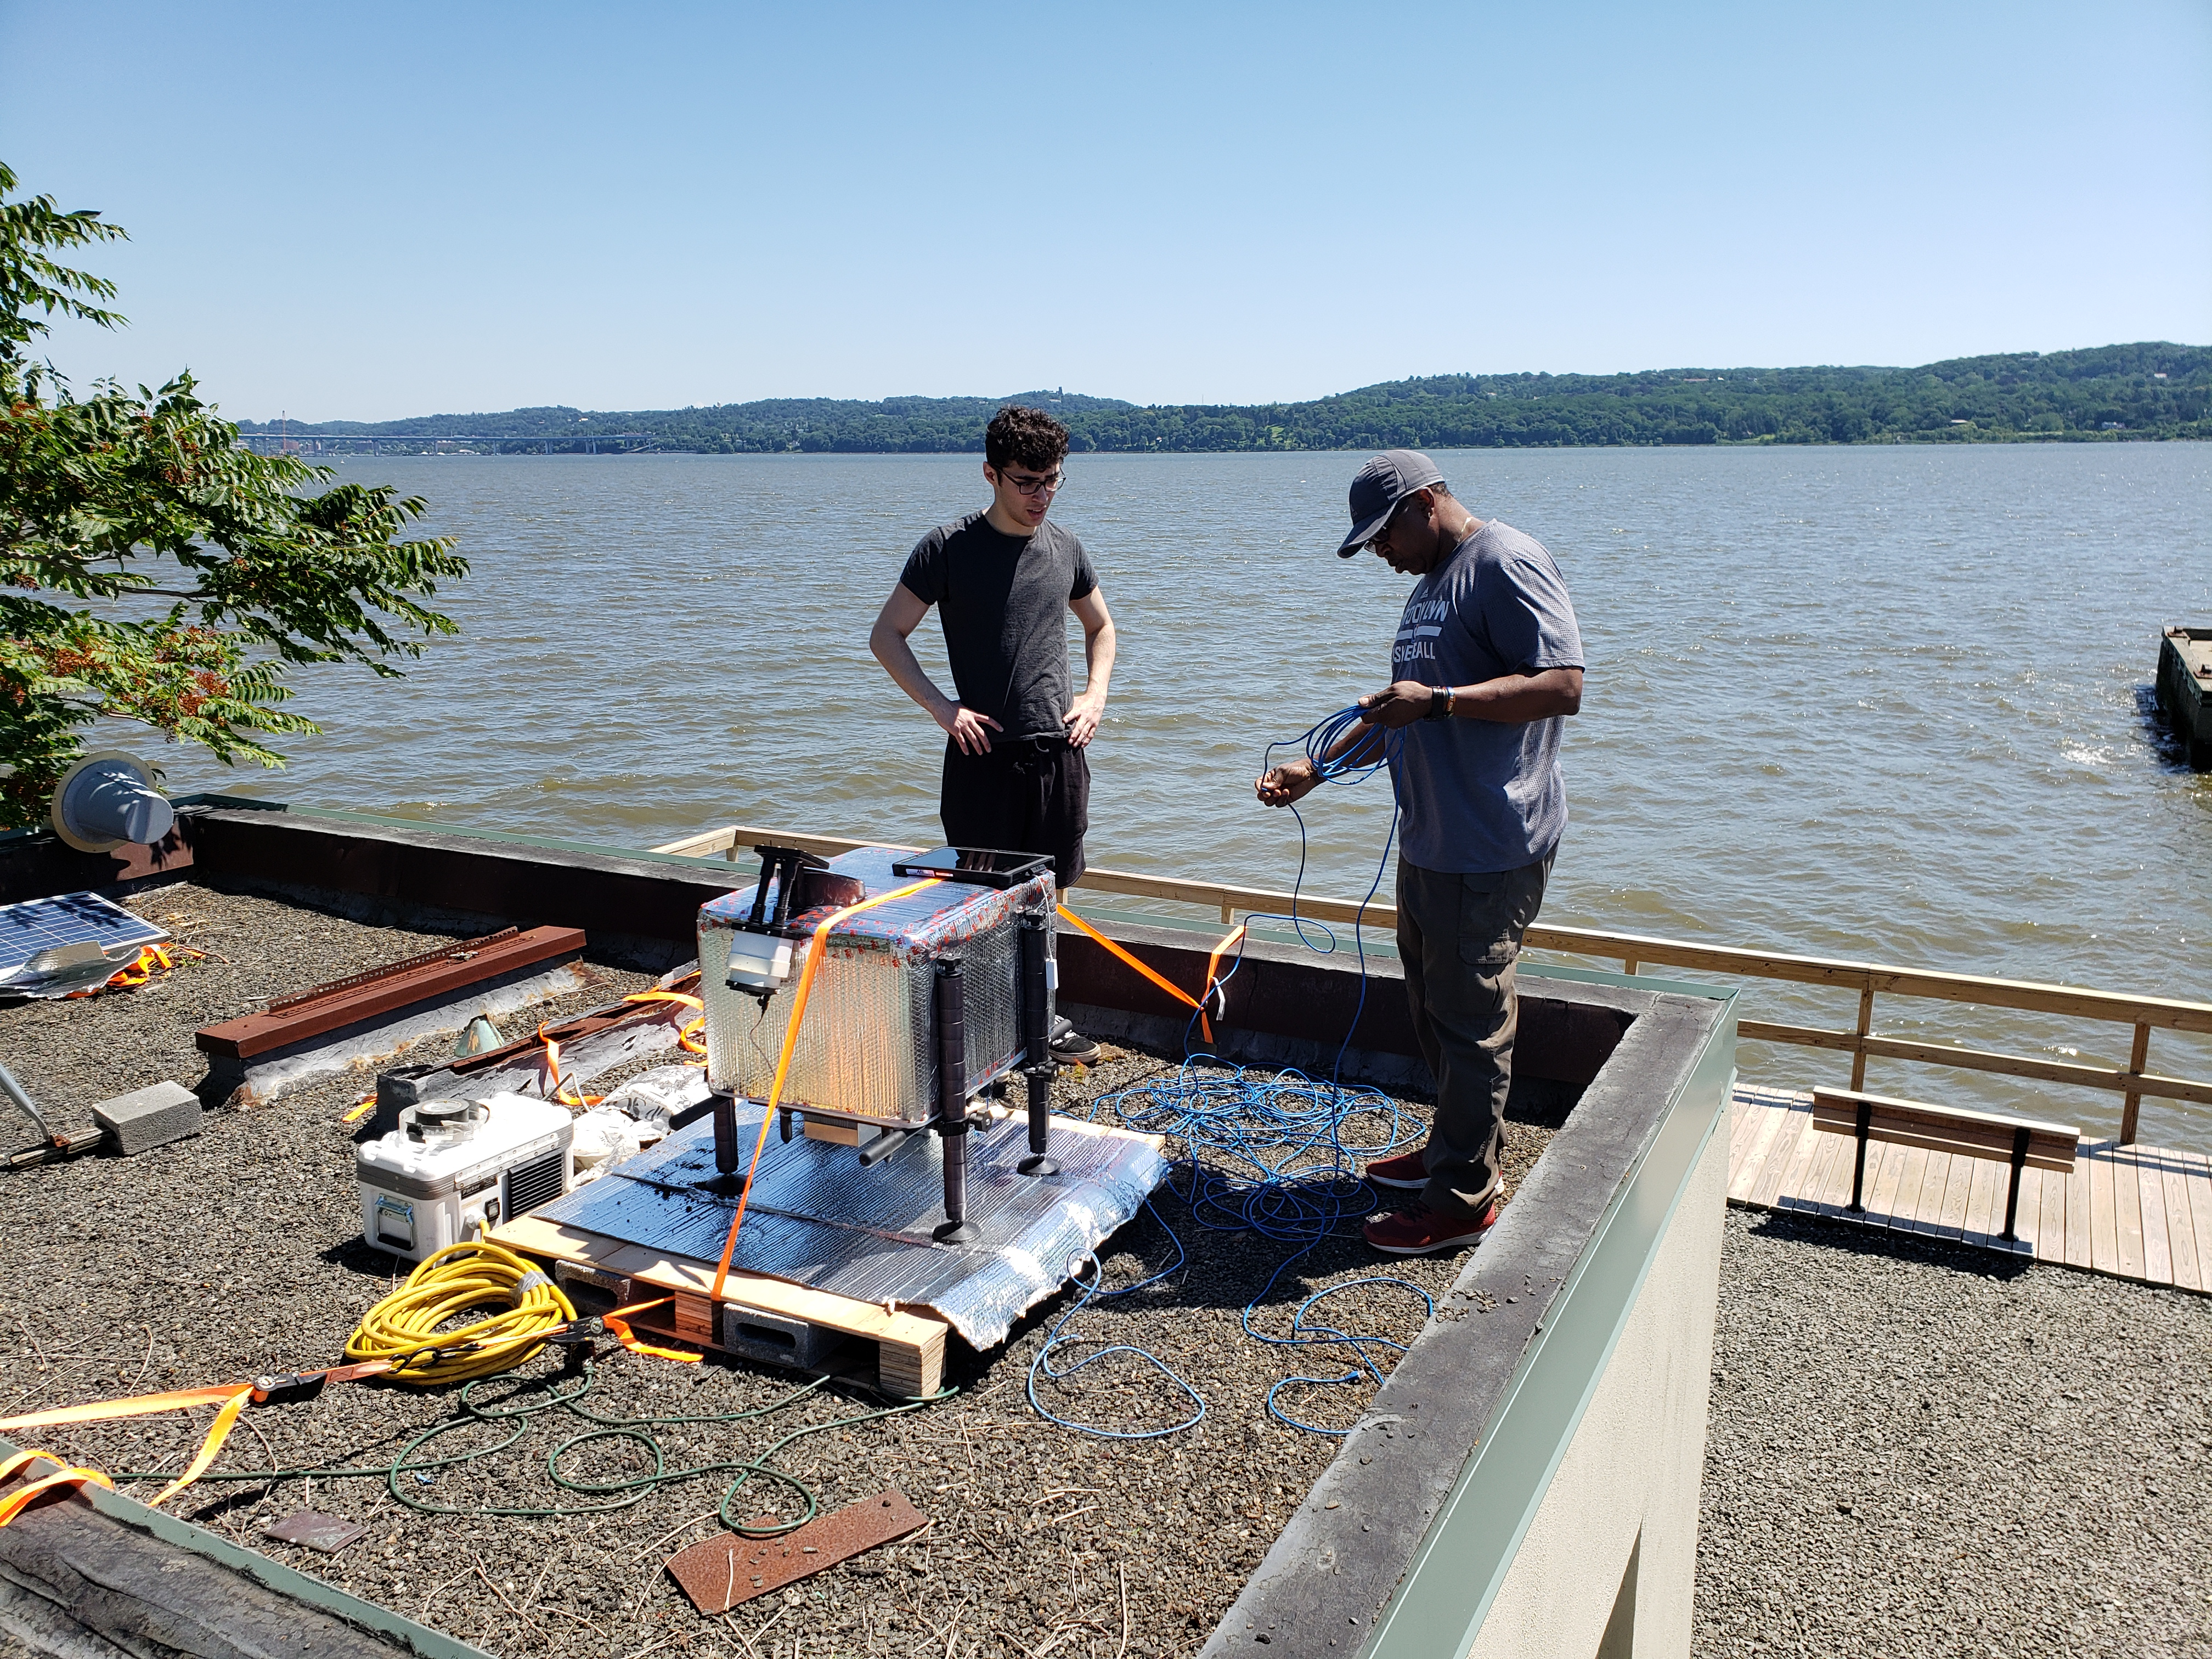
DOD/CCNY Deployment Efforts Observations and Results 2019
Remote Sensing & Modeling Sites
Comparing the Doppler Lidar located at Piermont Point to CCNY located Doppler Lidar During a select Event on August 27, 2019
DOD/CCNY Equipment at monitoring sites were as follows:
Leosphere 200S – CCNY (Groves School of Engineering)
HALO Streamline Doppler Lidar (Hostos Community College)
HALO Profiling Lidar 1 (Ft. Lee NJ; DEP)
HALO Profiling Lidar 2 (Piermont Point)

Slide 13
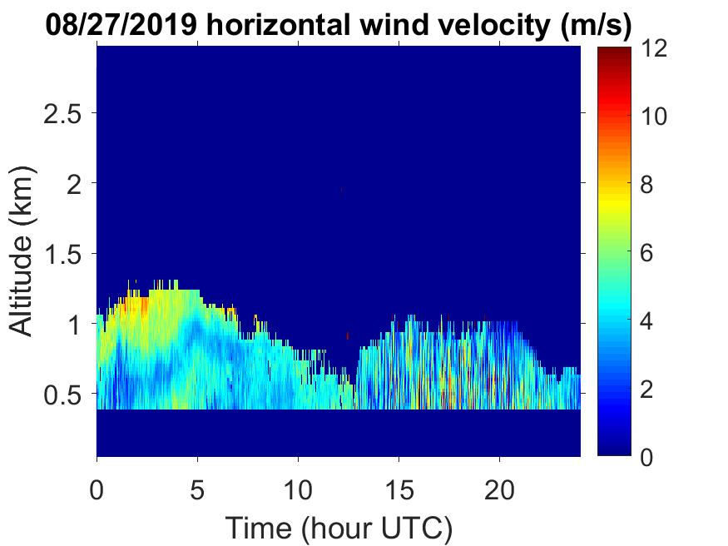
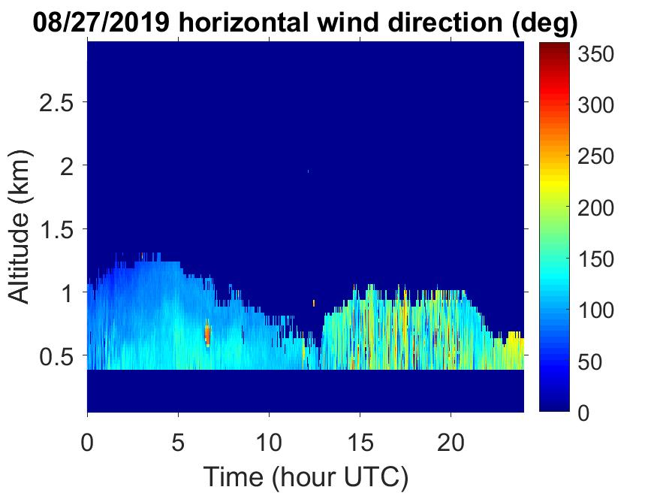
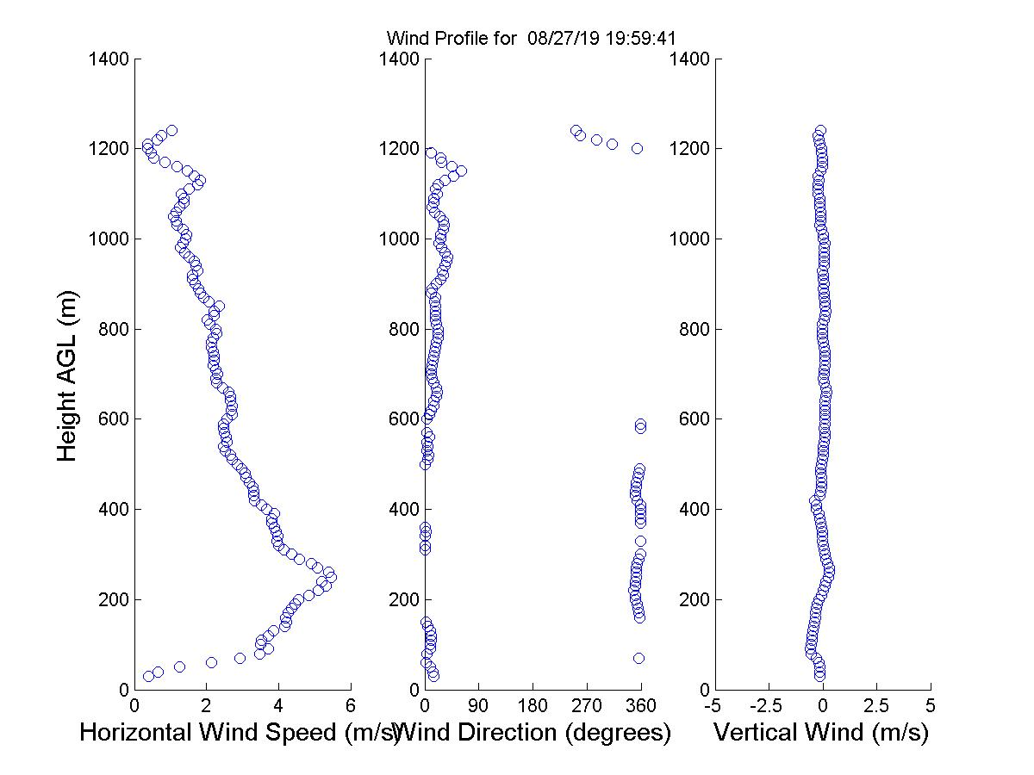
Select Event on 8/27/2019 - Low level Jets coming from the North Observed by Two Doppler Lidars
(One at CCNY in Manhattan Island and the Other located out on Piermont Point - Hudson River North of NYC)
Day Profile of Doppler Lidar
Located at CCNY
Doppler Lidar
Located on the Hudson River
Select time is 19:50 UTC (3:50 pm EDT)

Slide 14
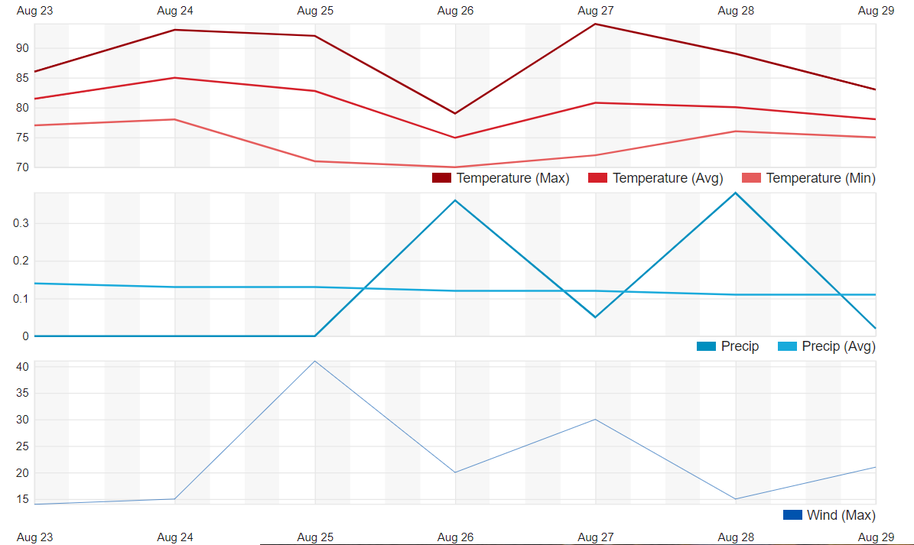
DOD/CCNY Deployment Efforts Observations and Results Select Event Aug 24/25, 2020 (Weekly Weather Station Data - LaGuardia Airport)

Slide 15
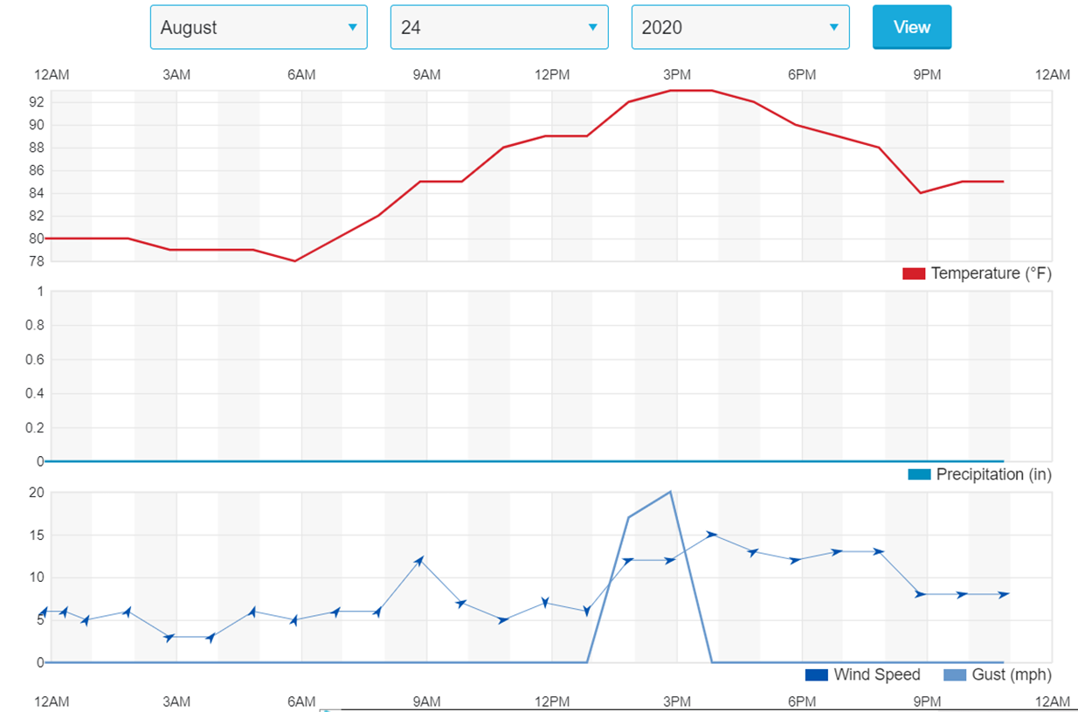
LaGuardia Airport NWS Weather Station Aug 24, 2020

Slide 16
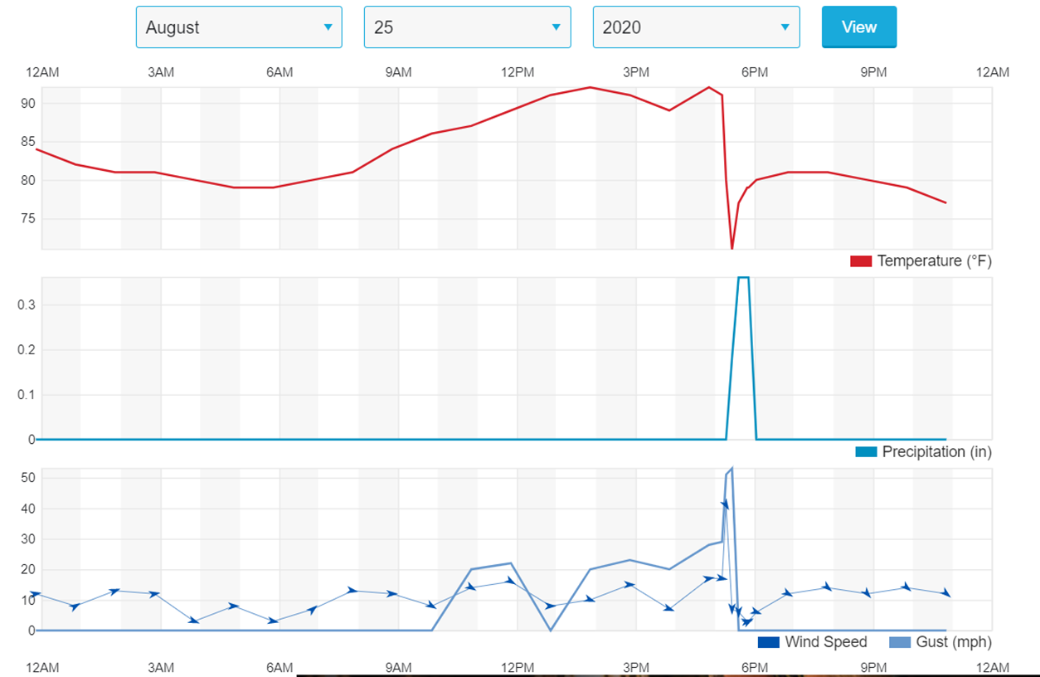
LaGuardia Airport NWS Weather Station Aug 25, 2020

Slide 17
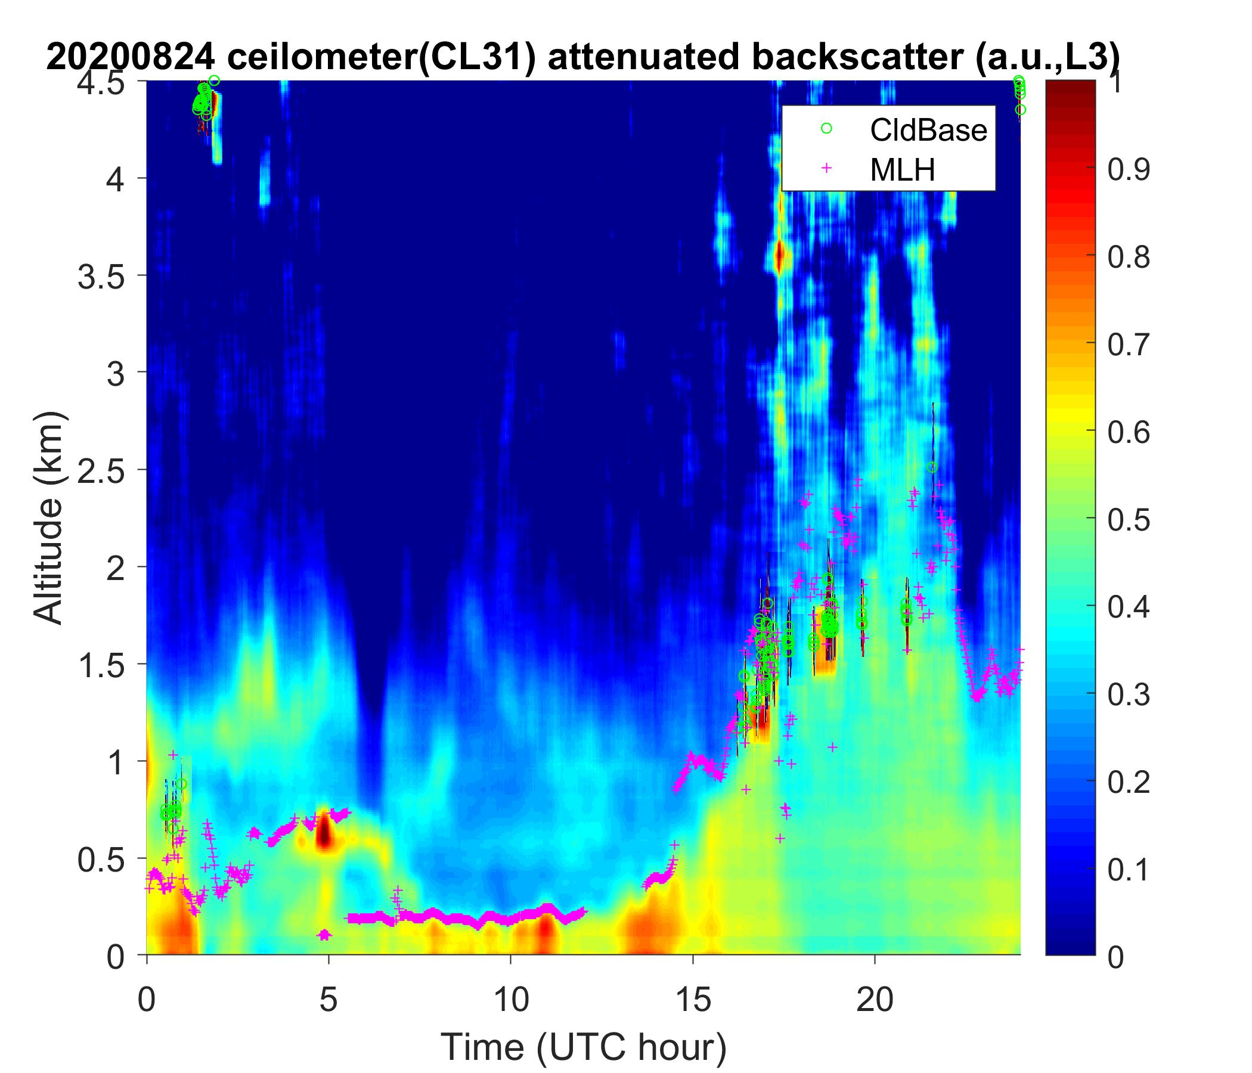
Select Event Aug 24, 2020 Vaisala Ceilometer On Rooftop at CCNY

Slide 18
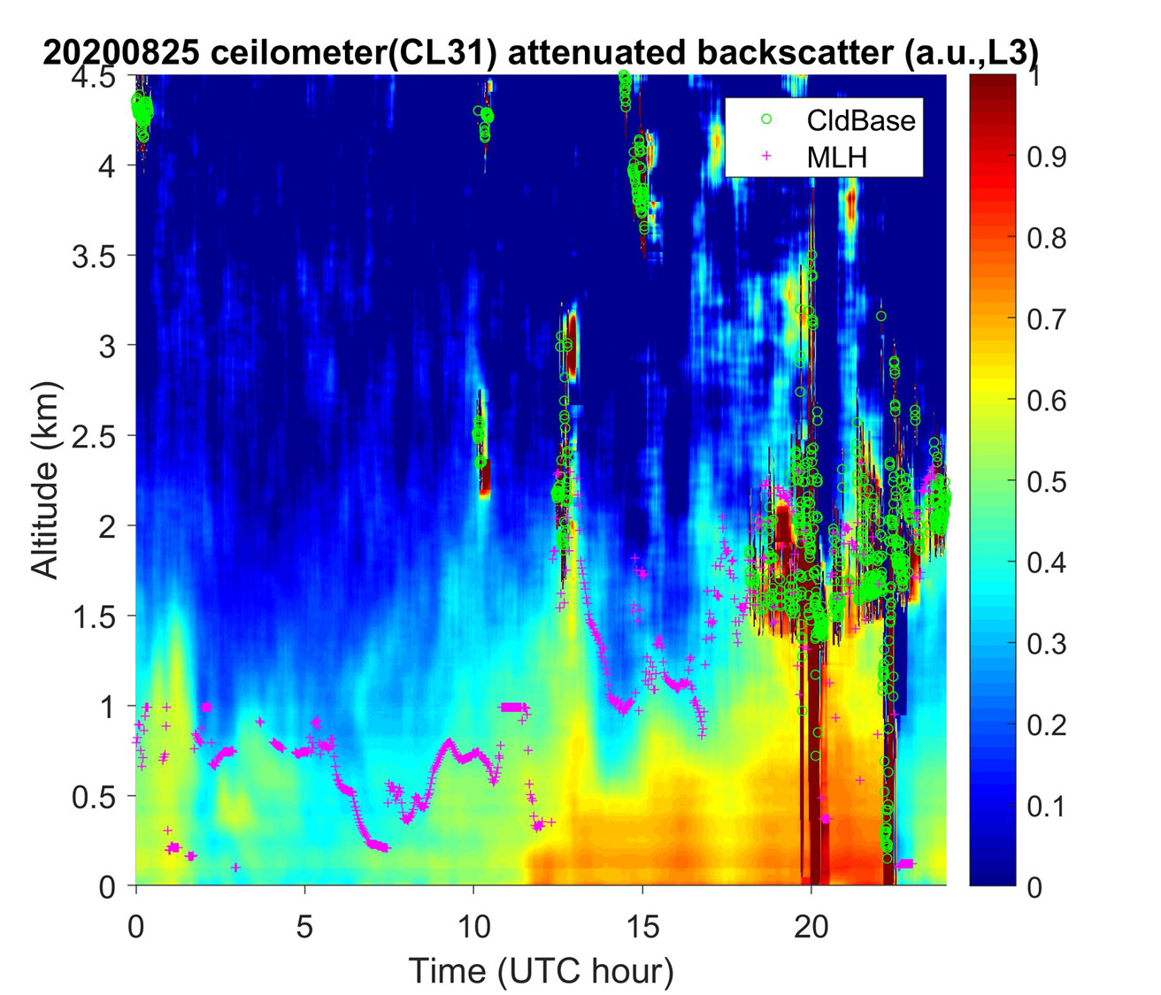
Select Event Aug 25, 2020 Vaisala Ceilometer On Rooftop at CCNY

Slide 19
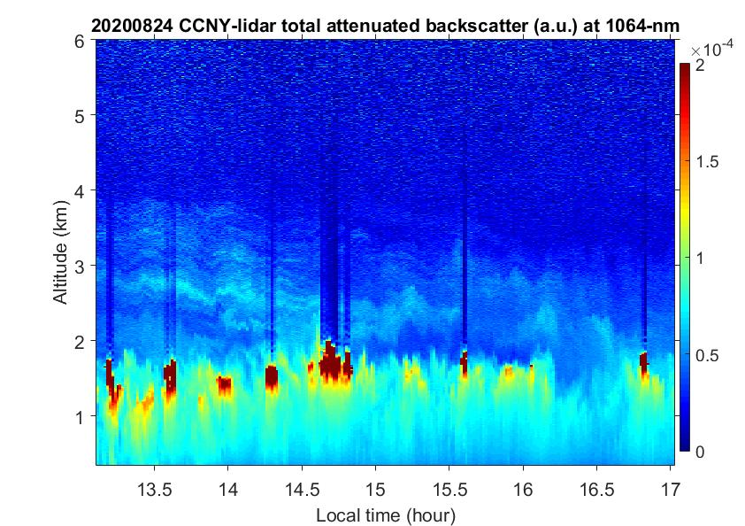
Select Event Aug 24, 2020 CCNY Raman Lidar On Rooftop at CCNY

Slide 20
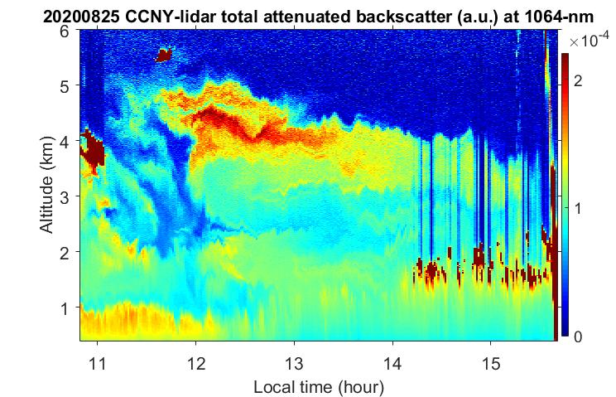
Select Event Aug 25, 2020 CCNY Raman Lidar On Rooftop at CCNY

Slide 21
Select Event Aug 25, 2020 CCNY Raman Lidar On Rooftop at CCNY

Slide 22
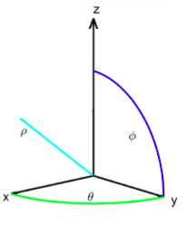
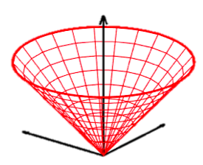
Select Event Aug 24/25, 2020 DOD Doppler Lidar On Rooftop at CCNY Doppler Wind LIDAR Strategy
Vertical Stare
ϕ : 90°
θ : N/A
Δz : 50 m
duration : 2 minutes
2. DBS Scan
ϕ : 75° (4), 90°
θ : 0°, 90°, 180°, 270°
Δz : 25 m
t : 5 minutes
3. RHI Scans
ϕ : 0-90
θ :
Δz : 50 m
duration : 1 minutes

Slide 23
Select Event Aug 24, 2020 DOD Doppler Lidar On Rooftop at CCNY
- Mean Wind Profile plot
- Turbulent Structure Plots near buildings

Slide 24
Select Event Aug 25, 2020 DOD Doppler Lidar On Rooftop at CCNY
- Mean Wind Profile plot
- Turbulent Structure Plots near buildings

Slide 25
Conclusions and
Future Studies
Observations indicate that the urban terrain has a major impact on the transport and turbulent nature atmospheric flows in the NY Metropolitain Area
Urban Heat Island effects impact the formation of turbulent structures and mixing layers.
Wind behavior and boundary layer mixing contribute to the transport of ozone throughout these states
Models and Observations indicate that the higher the boundary layer, more likely mixing will occur.
Fine scale observations and modeling is needed to understand the impact of heatwaves and transport of pollutants across State Boundaries.
Future studies (summer 2021) will include additional Lidars, Radars and Flux Tower Observations to help support planned campaigns in the NY Metro Area (e.g. AEROMA).
States that are interested in monitoring and regulating the formation of ozone can benefit from this study if they cooperate via science driven studies.

Slide 26
References
Yonghua Wu, Kaihu Zhao, Jianping Huang, Mark Arend, Barry Gross, Fred Moshary, Observation of heat wave effects on the urban air quality and PBL in New York City area, Atmos. Environ., 2019-10-01 , DOI: 10.1016/j.atmosenv.2019.117024
Melecio-Vázquez, David, Prathap Ramamurthy, Mark Arend, and Jorge E. González-Cruz. 2018. “Thermal Structure of a Coastal–Urban Boundary Layer.” Boundary-Layer Meteorology, May. https://doi.org/10.1007/s10546-018-0361-7.
Chen, Fei, Hiroyuki Kusaka, Robert Bornstein, Jason Ching, C. S. B. Grimmond, Susanne Grossman-Clarke, Thomas Loridan, et al. 2011. “The Integrated WRF/Urban Modelling System: Development, Evaluation, and Applications to Urban Environmental Problems.” International Journal of Climatology 31 (2): 273–88. https://doi.org/10.1002/joc.2158.
Meir, Talmor, Philip M. Orton, Julie Pullen, Teddy Holt, William T. Thompson, and Mark F. Arend. 2013. “Forecasting the New York City Urban Heat Island and Sea Breeze during Extreme Heat Events.” Weather and Forecasting 28 (6): 1460–77. https://doi.org/10.1175/WAF-D-13-00012.1.
Kaihui Zhao, Yunxuan Bao, Jianping Huang, Yonghua Wu, Fred Moshary, Mark Arend, Yongwei Wang, Xuhui Lee, “A high-resolution modeling study of a heat wave-driven ozone exceedance event in New York City and surrounding regions”, Atmos. Environ., 2019, 199, 368–379
Abdelazim, Sameh; Santoro, David; Arend, Mark; Moshary, Fred and Ahmed, S., "Development and Operational Analysis of an All-Fiber Coherent Doppler Lidar System for Wind Sensing and Aerosol Profiling," in IEEE Transactions on Geoscience and Remote Sensing, vol. 53, no. 12, pp. 6495-6506, Dec. 2015.
doi: 10.1109/TGRS.2015.2442955
Abdelazim, Sameh; Santoro, David; Arend, Mark; Moshary, Fred; Ahmed, Sam. 2018. "A Hardware Implemented Autocorrelation Technique for Estimating Power Spectral Density for Processing Signals from a Doppler Wind Lidar System." Sensors 18, no. 12: 4170
Boccippio, D. J., 1995: A diagnostic analysis of the VVP single-Doppler retrieval technique. J. Atmos. Oceanic Technol., 12, 230–248.
Browning, K. A., and R. Wexler. “The Determination of Kinematic Properties of a Wind Field Using Doppler Radar.” Journal of Applied Meteorology, vol. 7, no. 1, 1968, pp. 105–113., doi:10.1175/1520-0450(1968)007<0105:tdokpo>2.0.co;2.
A. Choukulkar, R. Calhoun, B. Billings and J. D. Doyle, "A Modified Optimal Interpolation Technique for Vector Retrieval for Coherent Doppler LIDAR," in IEEE Geoscience and Remote Sensing Letters, vol. 9, no. 6, pp. 1132-1136, Nov. 2012.
doi: 10.1109/LGRS.2012.2191762
.
Newsom RK, Ligon D, Calhoun R, Heap R, Cregan E, Princevac M. Retrieval of microscale wind and temperature fields from single- and dual-Doppler lidar data. Journal of Applied Meteorology. 2005 Sep;44(9):1324-1344. https://doi.org/10.1175/JAM2280.1
Newsom, Rob & Calhoun, Ron & Ligon, David & Allwine, Jerry. (2008). Linearly Organized Turbulence Structures Observed Over a Suburban Area by Dual-Doppler Lidar. Boundary-Layer Meteorology. 127. 111-130. 10.1007/s10546-007-9243-0.

Slide 27




Acknowledgements
Support is provided to allow Collaborations with DOD Army Research Laboratory
under a DOD ARO Grant # W911NF-20-2-0126
This study is partially supported by the NESCAUM (project #2411), New York State Energy Resources Development Authority (agreement # 137482), CUNY Interdisciplinary Climate Crisis Research Grant: #2746, NOAA Grant # NA16SEC4810008

Slide 28
Questions?
Contact:
Mark Arend
marend@ccny.cuny.edu
markarendphd@gmail.com
Electrical Engineering Department, CUNY City College of New York
NOAA-Center for Earth System Science and Remote Sensing Technologies, CUNY City College of New York

Slide 29
Extra Slides follow
The following 2 slides are sent to DAVID to discuss the DRAFT VERSION
The following two slides can be used to improve slide # 22

Slide 30
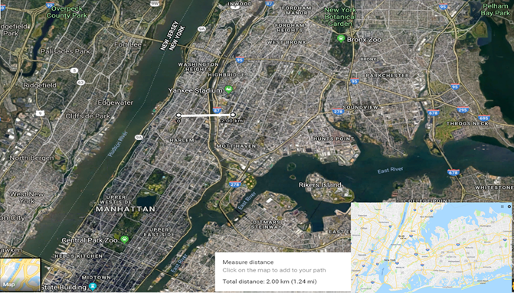
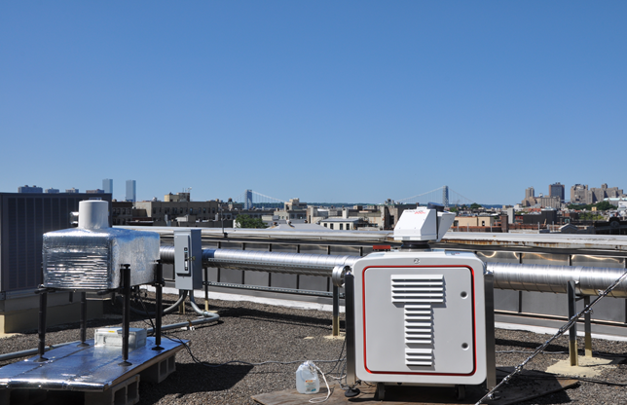
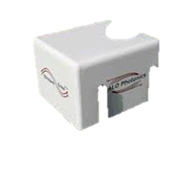
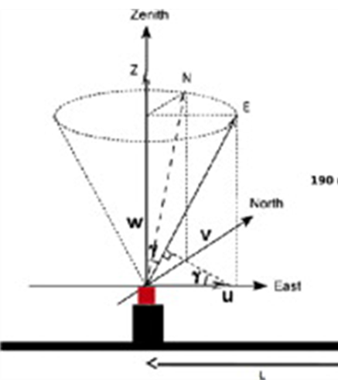
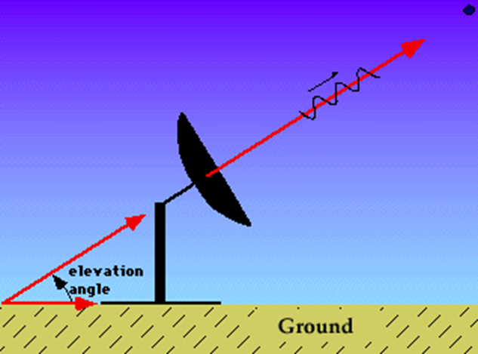
Profiling Instruments, and Scan Strategies
Three Co-operating
Doppler Wind Lidars
1
2
3
1. Halo Photonics Streamline
2. Halo Pro
3. Leosphere 200S
Range Height Indicator
(RHI) scan:
Lidar is scanned in
Elevation at a fixed
azimuth
(East in this case)
Conical Scan:
Profiles mean
wind fields

Slide 31
Doppler Wind LIDAR Strategy
Vertical Stare
ϕ : 90°
θ : N/A
Δz : 50 m
duration : 2 minutes
2. DBS Scan
ϕ : 75° (4), 90°
θ : 0°, 90°, 180°, 270°
Δz : 25 m
t : 5 minutes
3. RHI Scans
ϕ : 0-90
θ : pointing east
Δz : 50 m
duration : 1 minutes

